Slide 1
Resilience 2.0:
Computer-aided disaster management
Gerhard Chroust
Johannes Kepler University Linz Austria,
gerhard.chroust@jku.at
Georg Aumayr
Johanniter Österreich, Ausbildung – Forschung
georg.aumayr@johanniter.at

Slide 2
em. o. Univ.-Prof., Dipl.-Ing. Dr. techn.
Gerhard CHROUST , M.S.
1959-1965 Study
Technical University Vienna (Communication – Dipl.-Ing), and University of Pennsylvania, USA (Computer Science, MS.)
1966-1991 IBM Laboratory Vienna: Research/Development (Formal Definition of Programming Languages, PL/I, Microprogramming, Compiler Development, Software Engineering Environments (ADPS), Coordinating Academic Contacts)
1975 Doktorate - Technical University Vienna
1980 Habilitation - Johannes Kepler University Linz
1992 -2007 Professor for Systems Engineering und Automation, Johannes Kepler Univ. Linz (Software Engineering, Software Process Models, Software Engineering Environments -Entwicklungsumgebungen, Computer Assisted Cooperative Work, Systemtheorie, Human and Cultureal Aspects of Software Engineering)
since 2007 Professor emeritus

Slide 3
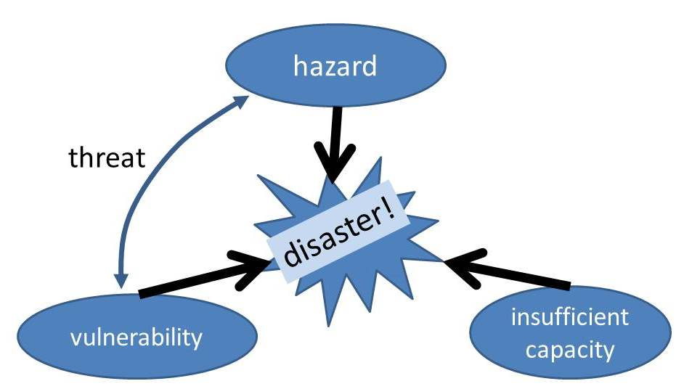
What is a disaster?
hazard … dangerous condition or event
vulnerability … likeliness to be injured
capacity … (internal) resources to withstand
consequences!
Notes:
to whom,?
definition

Slide 4
What is a disaster?
the functionalistic or event based perspective:
... a natural or man-made hazard taking effect ... of substantial
extent causing significant physical damage or destruction,
loss of life, or drastic change to the natural environment....
the social constructionism:
... are social constructions ... does not exist sui generis, ...
product of social definition:
"disasters are in the eye of the beholders".
the vulnerability perspective:
... consider vulnerability of the built environment and the social
vulnerability of exposed populations
Disaster = … external help needed

Slide 5


Disaster for whom?
depends on viewpoint!
psychology, environment,
who benefits who loses?
what‘s wrong with you?
I caught the
homo sapiens
virus!!!
Don‘t worry, within 150.000 years it goes away!
Notes:
2 businessmen in Hawai
fire – ensurqance , earthquke
How do you start an eqrhquakeprodice

Slide 6
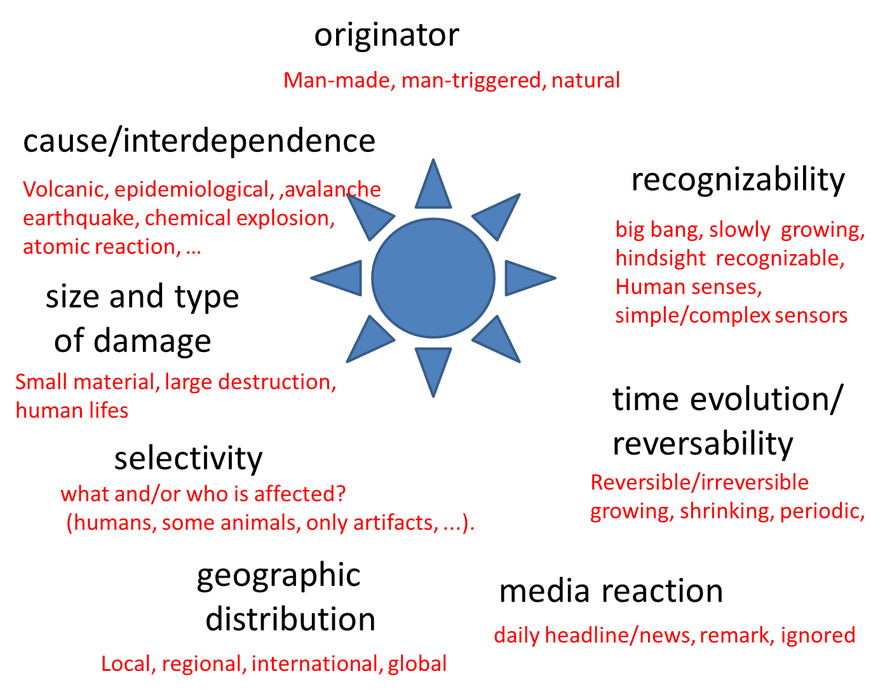
Classes of Disasters

Slide 7
Exernal hazards
different types of attacks
type – strength – risk
small attacks at a critical point
= big disturbance

Slide 8
Look into the future!
great! nothing serious happened yet!
Preparation!!!

Slide 9
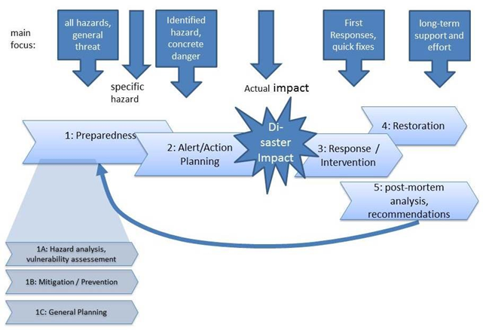
Disaster - Phases

Slide 10
Basic reactions
passive
active
FREEZE
FLIGHT, RUN AWAY
IGNORE/DENY
AVOID
preparation!
SUBMIT / SUSTAIN / ENDURE
FIGHT, INTERVENE

Slide 11
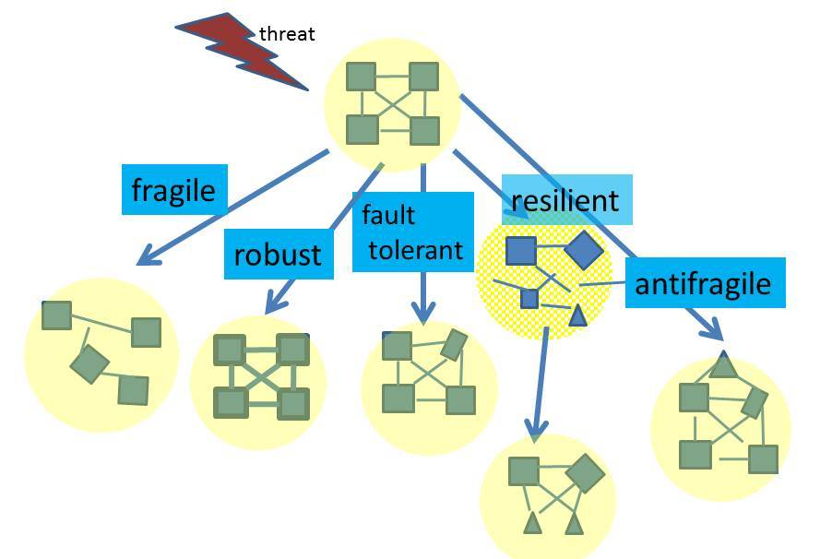
When it happens…
impact
Notes:
Sustainability?
marriage ?

Slide 12
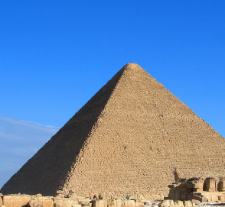
Reaction types
Fragility --- it breaks!
Robustness: undisturbed by certain defined attacks
Fault tolerance : against defined types of attack!
Resilience: the capacity of a ... system to bounce back to dynamic stability after a disturbance
Antifragility: the capacity of a systems that increase its resilience or robustness as a result of mistakes, faults, attacks, or failures.
  (this leads to improvemements! and applicability to new situations)

Slide 13
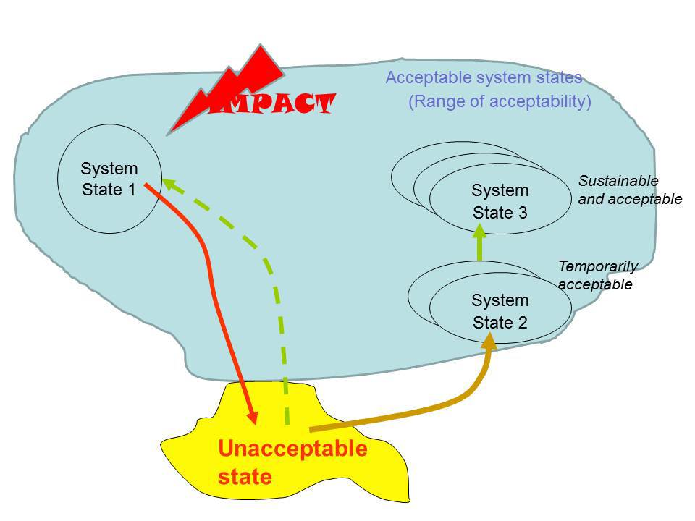
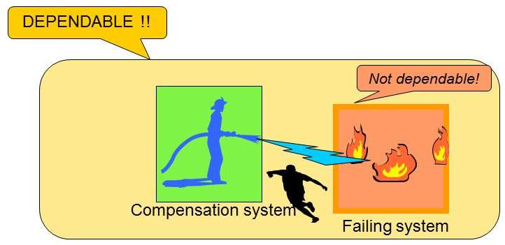
Resilience of what?
What is the system boundary?
Notes:
What means resilience?
depeds n system boundary
to whom?

Slide 14
System Complexity Types
Problem!
S: specification of the problem => solution
P: based on a view of the problem =>
find a solution
E: like P, but the solution will change the environment, i.e. the problem space
Solution ????
W (wicked): like E, but ill-defined defined problem and success, systemic, needs basic solution approach
H (hyperwicked): like W but additionally under time-pressure

Slide 15
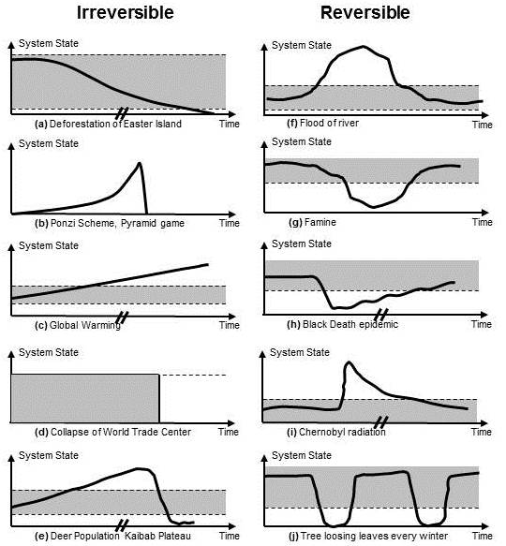
Recognition?
Types of disaster behaviour
with and without warning?
slow / fast onset ?
when do we recognize it ?
Notes:
with without warining
slow/fast on-set
rcognition? warningß
preparedness readyn
ess

Slide 16
Key Timings
T_{ident} … Time of identification of hazard
T_{rec} … Time of recognition of (expected) disaster
T_{exp} … Time of expected (EARLIEST) impact
t_{lead} … time for preparation = T_{exp} - T_{rec}
t_{alarm} … warning time = T_{exp} - NOW
t_{set-up} ... time needed to set-up intervention ressources

Slide 17
Resilience 2.0 – a new paradigm
Resilience 2.0 :
The capability of a system to exhibit resilience
by the integrated, effective and efficient use of
Information and Communication Technologies
through all phases of disaster management

Slide 18
Resilience 2.0 -> COMPUTER
higher speed – information processing and communication
better access to information
more processing power
  amount of processing, granularity and precision of information, storage size
higher mobility
  smart phone, internet, WLAN
new tools and methods
  virtual reality, simulation, GPS, …

Slide 19
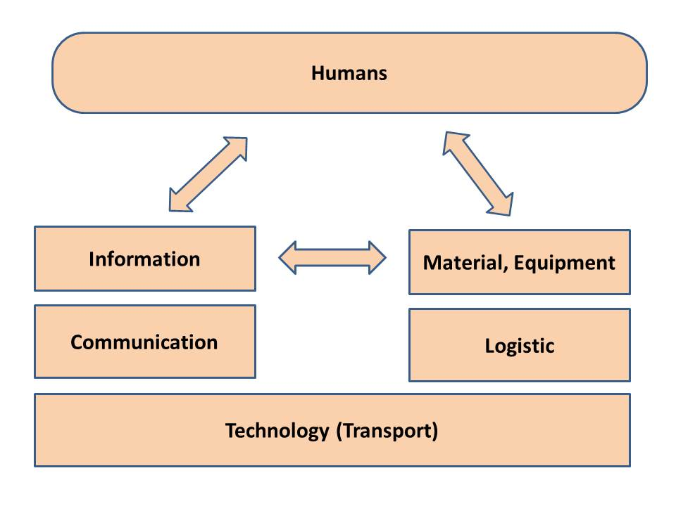
Resources

Slide 20
Computer Support
Big Data, analysis
Computer animation, Simulation
Crowd Sourcing
Crowd Tasking
Early Warning Systems
Electronic opinion surveys
Geoposition System (GPS), Google Earth, satellite photography
Multivariate Statistics
Process Management Tools
Project Management Tools
Robotics, autonomous vehicles, tele-guidance, tele-cooperation
Sensor technology
Social Media
Virtual Reality/ Mixed reality

Slide 21
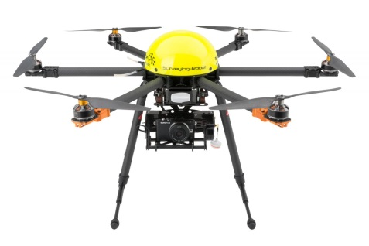
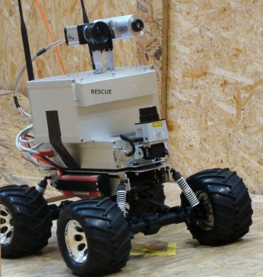


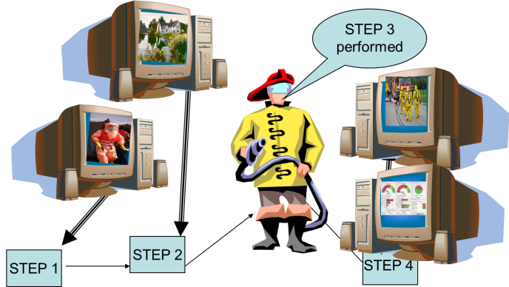
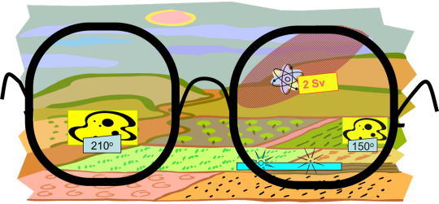
Training, Augmented Reality,
Robots, Communication
drone
Robot
communication
social media
Training
Augmented Reality
information processing

Slide 22
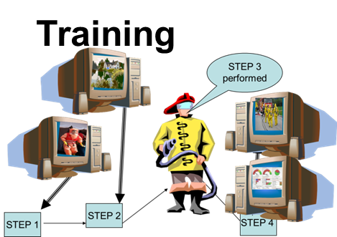


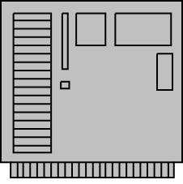
Resilience 2.0 and computers
Di-saster Impact
1: Preparedness
2: Alert/
Anticipation
3: Response / Intervention
4: Restoration
5: post-mortem analysis,

Slide 23
Communication
Communication with First Responders and feedback
data aggregation and situational analysis
public information and warning
Crowd sourcing of status information

Slide 24
Extended Horizon
look into the past: historical information
look into the future : simulation, prediction
look into the details: small indicative changes (automatic measuring, detection, signalling)
look to the side: larger system boundary

Slide 25
ICT : added problems
Performance Pressure : pressure/preemption of tasks,
ICT infrastructure : damages, no power, weak WLAN
Communication : equipment damaged, destroyed
Overloading: WLAN, social media
Press Media pressure: “bad news are good news”
professionals : incapacitated / not available
volunteers : not sufficiently trained

Slide 26
Summary
resilience (or antifragility!) highly desirable
different tools and support in different phases
ICT very helpful, but a risk factor in itself
new applications are appearing
Resilience 2.0 is here to stay and
to be improved!

Slide 27
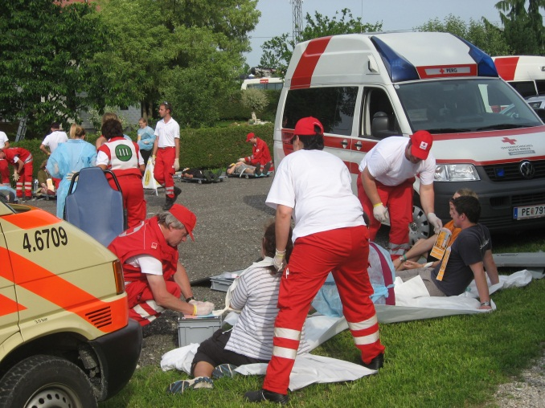
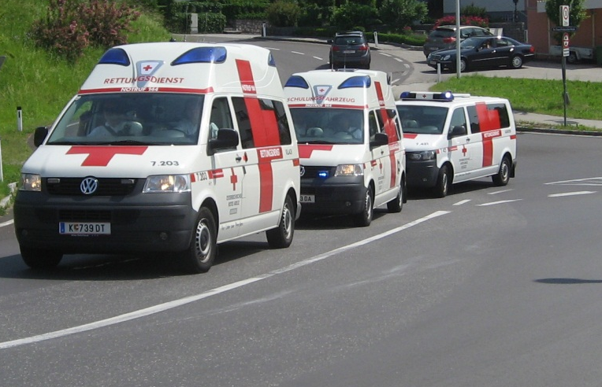
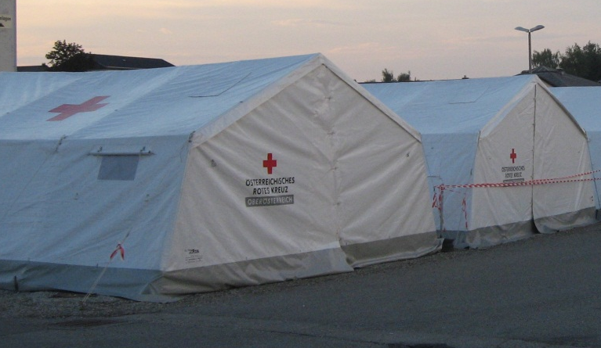
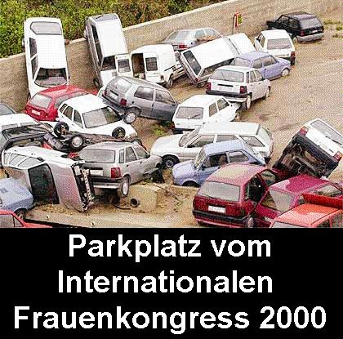
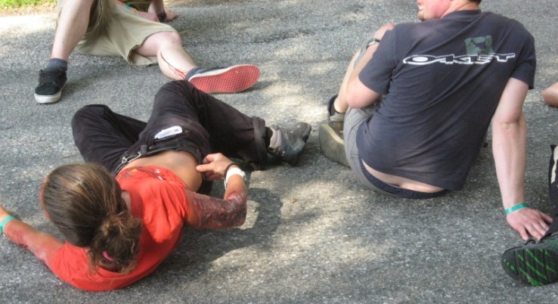
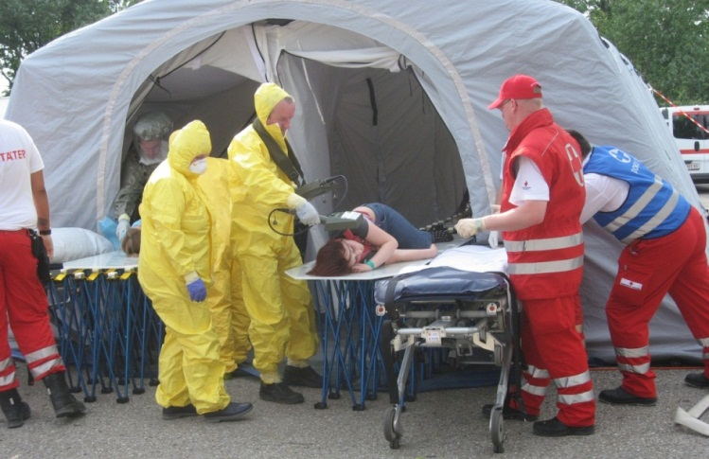
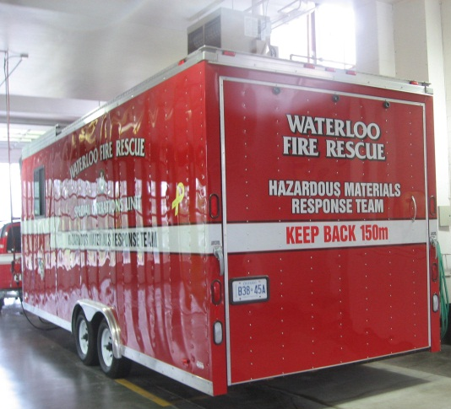
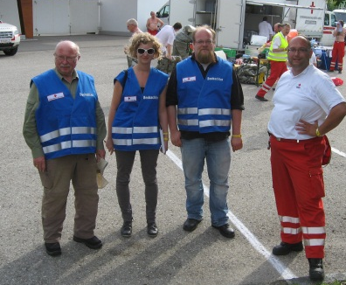
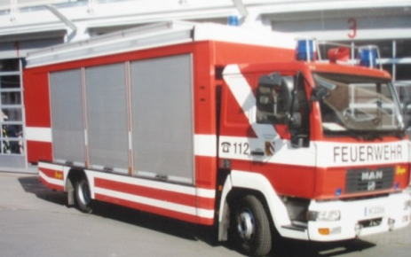
THANK YOU
FOR YOUR ATTENTION!
Gerhard Chroust, Georg Aumayr,
gerhard.chroust@jku.at, georg aumayr@johanniter.at
july 2005
27

