Slide 1
Summer 2016 Nanotech Fellows Program
Financial Instruments & Markets
June 8, 2016

Slide 2
Today’s Goals
Bonds
Call provisions; Covenants
Rights to liquidation
Bonds as an investment; Bond ratings
Common Stocks as an investment
Preferred Stocks
Private Equity Financing
Initial Public offerings
Investment Banking
Seasoned Issues
What is an Efficient Market?

Slide 3
Financial Executive as Marketing Executive
Financial executives need to raise money to finance the current operations and future growth of their companies
To do so they must market the future cash flows of their firm
Marketing entails the packaging of cash flows in order to fetch the highest price possible
Customers receive a piece of paper – stock certificate, bond, etc. on the nature of their claim on the firm’s future cash flow
Packaging cash flows involves security design
Designing securities requires knowledge of different financial instruments – this chapter focuses on
(a) financial instruments,
(b) the markets in which they trade
Next chapter will focus on a company’s choice of proper financing instrument

Slide 4
Financial Markets
Financial markets describes the distribution system by which cash-deficit entities engage in transactions with cash-surplus entities
Besides businesses, the entities in question include government agencies, universities, pension funds, endowments, individuals, commercial banks, insurance companies …
Money markets vs. capital markets distinguishes short-term vs. long-term contracts
In money markets, securities have a maturity of less than 1 year while capital markets have securities with longer maturity
Nonfinancial businesses rely on capital markets for financing

Slide 5
Financial Instruments
Companies do not face major constraints (law or regulation) when choosing financial instruments
Instruments must appeal to investors and meet the needs of the company
Markets for securities are regulated by the Securities and Exchange Commission (SEC)
SEC does not pass judgment on the merits of a security, although some states do have merit regulation
SEC regulations require adequate disclosure before purchase
When designing a financial instrument, a financial executive works with three variables
Investors’ claims on future cash flows
Investors’ right to participate in company decisions
Investors’ claims on company assets in the event of liquidation

Slide 6
Financial Instruments… The More Popular Types
Bonds
Stocks
Notes
Mortgages
Derivatives
Futures
Options
Hybrid, e.g., convertible debt
Direct claims on cash flows
Value derived on the value of the underlying asset

Slide 7
Categories of Assets
Assets
Financial
Debt (fixed claims)
Equity (resdual claims)
Physical
Home, Business, Machinery, etc
Derivatives (contingent)

Slide 8
Bonds… A Fixed-Income Security & Types
A form of indebtedness
Typically sold in small increments – main difference from other security forms
Say, $1,000 per bond
Three variables characterize a bond
Par value
Coupon rate
Maturity date
For example, a bond might have a $1,000 par value, 7% coupon rate, and
maturity date of December 2020
Treasury
Issued by federal government
No default risk (but not free of risk)
Corporate
Issued by corporations
Different levels of default risk
Municipal
Issued by state and local governments
Interest generally exempt from federal and state taxes
Foreign
Issued by foreign governments/firms
Additional risk if denominated in foreign currency
Corporate bonds have been the largest source of external financing at 37%; Loans and advances constitute 11%
In the past decade, 65% of financing has been internal – retained profits and depreciation

Slide 9
Relative Size… of Financing Sources
Historically, 65% of business financing has come from retained earnings and depreciation
37% of external financing has come from corporate bonds
11% has come from loans from banks and other financial firms
In 2010, small manufacturing firms rely on bank loans for 34% of their financing, vs. 8% for larger firms
Bond characteristics
Coupon rate, par value and maturity date
The periodic repayment of principal is known as sinking fund
Direct payment to creditors via repurchase or retirement at par value
Variable rate vs. fixed rate bonds

Slide 10
Call Provisions
Right to retire bonds prior to maturity
Call price is typically a modest premium above par
Delayed call prevents retirement earlier some date – 5-10yrs
Call options help companies
take advantage of declines in interest rates to issue new ones and
rearrange capital structure
Investors require a premium for call provisions
From company’s perspective, it looks like “heads I win, tails you lose”
The more attractive the call provisions are to the issuer, the higher the coupon rate on the bond

Slide 11
Protective Covenants
Contractual terms to protect bondholders by impacting management decisions through indenture agreements
Examples:
Lower limit on current ratio
Upper limit on D/E ratio
Required approval by bondholders before major acquisition or sale of assets
Bondholders have no direct say in a company unless it defaults on its interest, sinking fund, or covenant obligations
Creditors can force the company into bankruptcy and
Liquidation – sale of assets to meet obligations

Slide 12
Federal Bankruptcy Law… Highlights
Federal Bankruptcy Law
Chapter 11
Business reorganization
Chapter 7
Business liquidation
Applies when Chapter 11 isn’t feasible
Chapter 9
Financially distressed municipalities
Chapter 13
Adjustment of debts for individuals

Slide 13
Liquidation under Chapter 7… Priority of Claims
Rights of absolute priority – determines the distribution of liquidation proceeds
Admin expense of the bankruptcy process
Claims taking statutory priority, e.g., tax claims and wages due workers
Unsecured creditors’ claims – senior creditors.
Subordination agreements which specify that certain unsecured creditors rank above others
Equity holders
Preferred stockholders
Common stockholders
Equity shareholders may get nothing since all prior classes are paid off first!
Secured creditors are outside the priority ordering

Slide 14
Secured Creditors
Secured credit involves collateral
In liquidation, proceeds from the sale of collateral only go to the secured creditor, up to the amount of the secured credit
Any residual goes into the pot shared by the pool of investors – general creditors
If the sale of collateral is insufficient, the secured creditor becomes a general creditor for the balance

Slide 15
Bonds as an Investment
Bonds are not as safe as previously believed
Nominal vs. real (inflation adjusted) returns
See the table below
Can you infer the long-run default premium on corporate bonds?
Can you infer the real long-run return to bonds?
Rate of Return on Selected U.S. Securities, 1900 - 2010
Risk premium

Slide 16
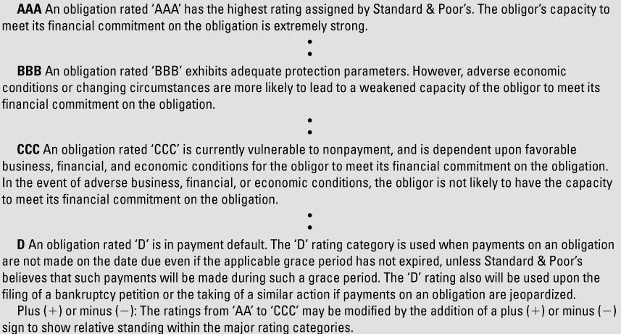
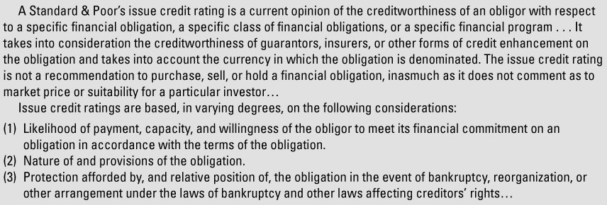
Bond Ratings …Some S&P Debt-Rating Definitions
Rating agencies rate bonds for risk
Analysts use techniques discussed in earlier chapters, such as debt ratios and coverage ratios

Slide 17
Junk Bonds
Investment-worthy grade is “BBB” and above
Institutional investors are now prohibited from investing in bonds rated less than this
Junk bonds, or speculative or high-yield bonds, are below investment grade
Junk bond market is an alternative to bank and insurance company loans for smaller, less prominent companies
Junk bonds have been used to finance mergers and acquisitions

Slide 18
Ratings Firms and the Financial Crisis
Rating agencies partly fostered the recent financial crisis
Criticism of excessive optimism in ratings of complex mortgage-based securities
Error #1 ➔ discounted the fall in housing prices
Their models indicated that if any decline, it would be regional
Error #2 ➔ ignored the deterioration in mortgage lending standards
Ignored the study of individual loan files because they are only to rate the quality of the security and not the underlying mortgages – they are not loan officers

Slide 19
Stocks… A Residual-Income Security
Gives the stockholder a claim on any income remaining after the payment of all obligations, including interest on debt
Main types of stock
Preferred
Hybrid (like debt in some ways, and equity in others) -- “cheap equity”- no voice in management
Debt – It is a fixed-income security
Equity – The board may choose not to distribute dividend
Common
Classified, Class A and Class B, to meet special needs of the firm -- No standard meanings
Shareholders are represented through a board of directors, through which they exercise control
The degree of control is variable, in terms of the fraction of share ownership required to control the board

Slide 20
Checks on Management
Management might control the board – no dominant group
Checks against this:
Product market competition – provide good product at competitive price
Need for external financing – maintain profitability to attract money
Market for corporate control – stock price may suffer; hostile takeover
In Europe, banks take equity positions and exercise direct control, more so than in the US
Japanese keiretsu has same effect as in Europe
Trends
Europe and Japanese framework involves “old boy” relationships
European firms have come to shift source of funding to public markets instead of banks
Japanese boards have begun to focus more on stock returns, thereby leading to less cross-share holdings

Slide 21
Common Stock as an Investment
Common stock holders receive two types of investment returns:
Dividends and possible share price appreciation
Total return = dividend yield + capital appreciation
Between 1928 and 2010, dividend yields on large common stocks were 3.9%, and capital appreciation was 7.2%
Recent decade ➔ 1.9% and 1.7%
In general stocks are a hedge against inflation
1970s were an exception to the rule, when stocks returned 5.2%, and inflation grew at 11.7%

Slide 22
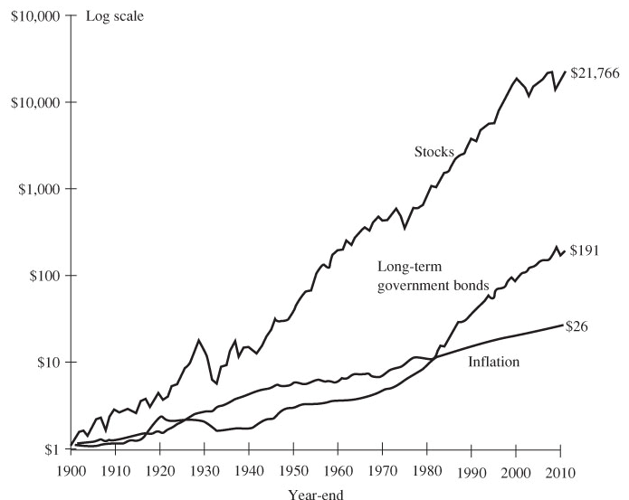
Equity Premium
Stocks returned 6.2% more than government bonds between 1900 and 2010
The real return to stocks over this period was 8.3%
$850
$7.50
Accounting for Inflation

Slide 23
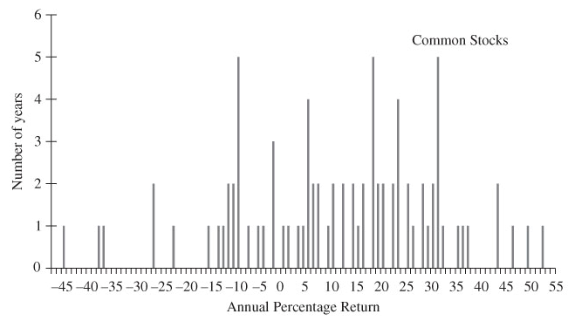
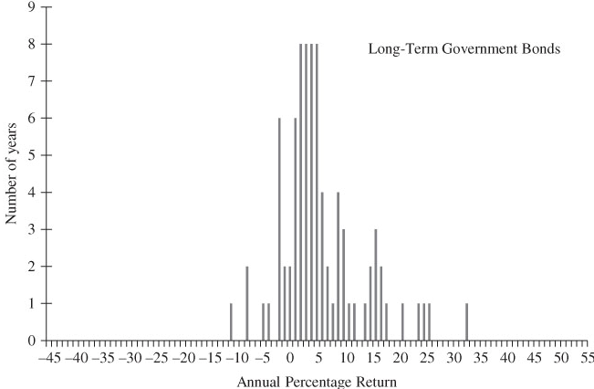
Stock and Bond Returns (1928-2010)

Slide 24
Stocks
Preferred Stocks
Hybrid security, mixing features of both debt and equity
Promises annual fixed dividend = coupon rate x par value
Dividend discretionary
Dividend is not tax deductible, in contrast to interest payments
Cumulative Preferred
Preferred shareholders have higher priority than common shareholders
Common shareholders receive no dividend until preferred shareholders are paid in full, including past arrears
Control features of preferred stock vary from required approval to no voice at all unless dividend payments are in arrears
Perspectives on Common Stocks
Some managers view preferred as cheap equity, because the dividends are fixed even when earnings grow
Other managers view preferred as debt with a tax disadvantage

Slide 25
Financial Markets… Typical Types
Spot markets
Futures markets
Money markets
Mortgage markets
World, national, regional markets
Primary markets
Initial public offering markets
Secondary markets
Private markets
Our focus

Slide 26
Capital Formation… Three Ways Capital is Transferred
Direct transfer
Firm sells stocks or bonds directly to savers, without going through a financial institution
Through an investment banking house
Underwriter serves as the middleman and facilitates the issuance of securities
Through a financial intermediary
A bank, mutual fund, and the like
Three illustrative cases of financial markets:
A startup
A candidate for an IPO
A multinational

Slide 27
Private Equity Financing
Startup, too risky for bank lending and too small for to attract the attention of investors in public markets
Funding options include loans against stable cash flows such as personal savings, friends and family, venture capitalists, and strategic investors
Venture Capitalists
Wealthy investors, often referred to as “angel investors”
Professional venture capital companies, who make high risk investments in entrepreneurial businesses capable of rapid growth and high investment returns.
Big stakes, active role in management, investment horizon of 5-6 years (with a return 5-10x their initial investment)
View many proposals and are highly selective
Private Equity Partnerships
Structured as limited partnerships with a specified duration such as 10 years
General partner is the private equity firm, which raises a pool of money from limited partners, such as institutional investors and insurance companies
Limited partners have limited liability
Typical fee structure is 2% and 20%, the sum of a management fee and carried interest

Slide 28
Value and Investment Horizon
Private equity partnerships induce managers to work for them, creating value over the long-run without having to manage to short-run fluctuations
The horizon is long-run, but not the very long-run, so managers are under pressure to create a cash exit event for private equity investors
How big is private equity?
Add up the number of workers in companies in private equity firms portfolios
5 of 10 biggest American employers is a firm whose stock is in one of these portfolios:
For example, KKR with more than 800,000 employees (in firms including HCA and Toys “R” Us) in the second largest private employer after Walmart

Slide 29
Initial Public Offerings
Six years ago, Genomic Devices
raised $15 million from venture capitalists
had two more rounds of funding ($40 million)
needs a $25 million equity infusion to keep growing now that it’s successful – sales of $125 million and annual growth of > 40%
IPO can provide additional equity along with an exit route for venture investors

Slide 30
Investment Banking
“Bake off” to assess proposals from investment banks and choose one
Winning investment bank becomes the “managing underwriter” and begins to
advise the company on security design
register the issue with the SEC (30-90 days)
orchestrates a “road show”
assembles an underwriting syndicate who engage in book building

Slide 31
IPO Risks
Syndicate acts as wholesaler
Offer price set hours before stock goes public
Company bears price risk during the registration process
Syndicate bears risk associated with unsold shares, which they cannot sell above the offer price

Slide 32
Seasoned Issues
Shelf registration
Multinational firm wants to raise $200 million in new debt, using a U.S. “shelf registration”
Shelf registration is a general purpose registration, good up to two years, that allows the firm to get quick approval for the use public markets
A single underwriter often buys the entire issue
Competitive bids lower the issue costs
Market timing
Shelf registrations provide managers with ability to time issues of new equity
“Universal” shelf registrations provide flexibility in respect to choice of debt or equity, and public announcement of intentions
Private placement
Large corporations can avoid registering with the SEC by placing debt privately with one or more institutional investors
The private placement market might be half the size of the public market, excluding bank loans
Attractive option if public investors not especially receptive for reasons of complexity or familiarity

Slide 33
SEC Rule 144A (1990)
In the past, privately placed debt was not especially liquid
SEC Rule 144A now allows for trading of privately placed debt among institutional investors
Result is two parallel markets for corporate securities, one public and the other among institutional investors

Slide 34
International Markets
Large corporations use foreign financial markets because they want the contract to be in a foreign currency, they can get a better terms than in the U.S.
Foreign markets often impose fees and restrictions on foreign investors
International markets allow the currency specified in the transaction to be outside the control of issuing country’s monetary authority

Slide 35
Reserve Requirements and Bearer Bonds
Financial firms operating in international markets need not hold reserves with a central bank such as the Fed
Unlike the U.S., which requires registration of ownership, bonds can be issued to anonymous bearers, who can collect interest payments and avoid paying tax
Bearer bonds are cheaper for issuers
Have international markets stripped away protective regulation?
U.S. Regulations
Sarbanes-Oxley
Dodd-Frank
Will these drive business away from the U.S.?
Lower IPO activity
Shadow markets

Slide 36
Issue Costs
For privately negotiated transactions, the issue cost amounts to the investment banking fee
For public issues, there are also legal, accounting, and printing fees
Investment bankers often underprice issues to quell investors’ concerns about information asymmetries
Implicit dilution cost to shareholders
Representative cost comparisons
2.2% for straight debt
3.8% for convertible bonds.
7.1% for secondary offerings of public companies
11% for IPOs
Economies of scale:
For equity 3% @ $100 million becomes 20% for $500,000
For debt, range can be 0.9% to 10%

Slide 37
The Stock Market… The Most Active Secondary Market
Two basic types
Physical location exchanges
New York Stock Exchange
American Stock Exchange
Electronic dealer-based markets
Nasdaq
Over-the-counter
Electronic communications networks

Slide 38
Efficient Markets – how prices respond to new information
A recurring issue in raising new capital is timing
Managers devote considerable time and energy into predicting future price trends in financial markets
Should managers abandon prediction and timing because markets fully reflect all available information correctly into prices?
Controversial Issues
Evidence about market efficiency has been overstated
Working assumption is that markets are more or less efficient
Degree of efficiency is an empirical question

Slide 39
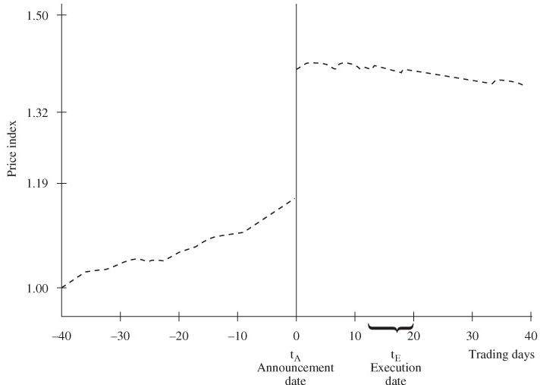
What is an Efficient Market?
Issue is how competitive prices respond to new information
How long does it take for news to impact prices?
Ederington-Lee analysis of interest rate and foreign exchange markets is that for news releases, the answer is 10-40 seconds
Time Series of the Mean Price Index of the Shares of 161 target Firms Involved in Successful Tender Offers

Slide 40
Efficiency in Degrees
A market is
weak-form efficient when prices fully reflect all information about past prices
semi-strong form efficient when prices fully reflect all publicly available info.
strong form efficient when prices fully reflect all information, public or private
Empirical evidence
Markets are not strong form efficient
With limited exceptions, markets are semi-strong form efficient
Typical investors should not expect to earn abnormal returns trading on publicly available information, especially if they pay brokerage commissions
Future studies might uncover inefficiencies not generally known about at present

Slide 41
Implications of Efficiency
When market are semi-strong form efficient, a series of statements hold true
Publicly available information has no predictive power in respect to market prices
Best forecast of future price is current price adjusted for trend
It is pointless to time the purchase or sale of the firm’s securities
Investors cannot expect to earn positive risk-adjusted returns
Bubbles and Efficiency
Two notions of efficiency:
Markets are unbeatable
Prices are rational and coincide with intrinsic value
Bubbles can occur in unbeatable markets that are not rational
Important to distinguish in context of bubbles and the financial crisis

Slide 42
Case Study 1
Summer 2016
Session 3
06/08/2016

Slide 43
Case Study 1: Capital Investment to Improve Yield
Many engineering projects aim at improving facility utilization and process yields
This case study illustrates an engineering economy analysis related to the redesign of a major component in the manufacture of semiconductors
Semiconductor manufacturing involves taking a flat disc of silicon, called a wafer, and depositing many layers of material on top of it
Each layer has a pattern on it that, upon completion, defines the electrical circuits of the finished microprocessor
Each 8-inch wafer has up to 100 microprocessors on it. However, the typical average yield of the production line is 75% good microprocessors per wafer

Slide 44
Capital Investment to Improve Yield
At one local company, the process engineers responsible for the chemical vapor-deposition (CVD) tool that deposits one of the many layers have an idea for improving overall yield
They propose to improve this tool’s vacuum with a redesign of one of its major components
The engineers believe the project will result in a 2% increase in the average production yield of non-defective microprocessors per wafer
The company has only one CVD tool, and it can process 10 wafers per hour
The process engineers have determined that the CVD tool has an average utilization rate (i.e., “time running”) of 80%
A wafer costs $5,000 to manufacture, and a good microprocessor can be sold for $100
The semiconductor fabrication plants (“fabs”) operate 168 hours per week, and all good microprocessors produced can be sold

