Slide 1
2. Time Value of Money
Summer 2016
Session 2
06/07/2016

Slide 2
Objective
The objectives of today’s class are:
to explain and make time value of money calculations, and
to illustrate the concept of economic equivalence of money
Notes:
Also G, g -- introduced later

Slide 3
Money & Time Value
Money has a time value:
Capital refers to wealth in the form of money or property that can be used to produce more wealth
Engineering economy studies involve the commitment of capital for extended periods of time
Notes:
Also G, g -- introduced later

Slide 4
Time Value of Money: 2 Approaches
Simple Interest
When the total interest earned or charged is linearly proportional to the initial amount of the loan (principal), the interest rate, and the number of interest periods, the interest and interest rate are said to be simple!
Compound Interest… the correct way!
Compound interest reflects both the remaining principal and any accumulated interest

Slide 5
Compound Interest

Slide 6
Simple vs. Compound Interest on $1000 @ 10%

Slide 7
Economic Equivalence
Allows us to compare alternatives on a common basis
Each alternative can be reduced to an equivalent basis dependent on
interest rate,
amount of money involved, and
timing of monetary receipts or expenses
Using these elements we can “move” cash flows so that we can compare them at particular points in time

Slide 8
Future Equivalent

Slide 9
Example 1

Slide 10
Example 2
“How much do I need to invest now to get $1000 after 5 years at 12% interest per year?”
F = $1000
0 1 2 3 4 5 years
P = ?

Slide 11
Example 2
F = $1000
0 1 2 3 4 5 years

Slide 12
Example 3
“What is the ‘rate of return’ for an investment of $1000 that returns $1,762.34 after 5 years?”
F = $1762.34
0 1 2 3 4 5 years
P = $1000

Slide 13
The “rate of return” of the investment is 12%
Example 3

Slide 14
The Rate of Return
In the real world, many different terms are used to describe the rate of return needed to justify an investment:
“MARR” Minimum Attractive Rate of Return
“Discount Rate”
“Opportunity Cost of Capital” (OCC)
“Hurdle Rate”

Slide 15
Equivalence of Cash Flows
F = ?
A = ?
P = ?

Slide 16
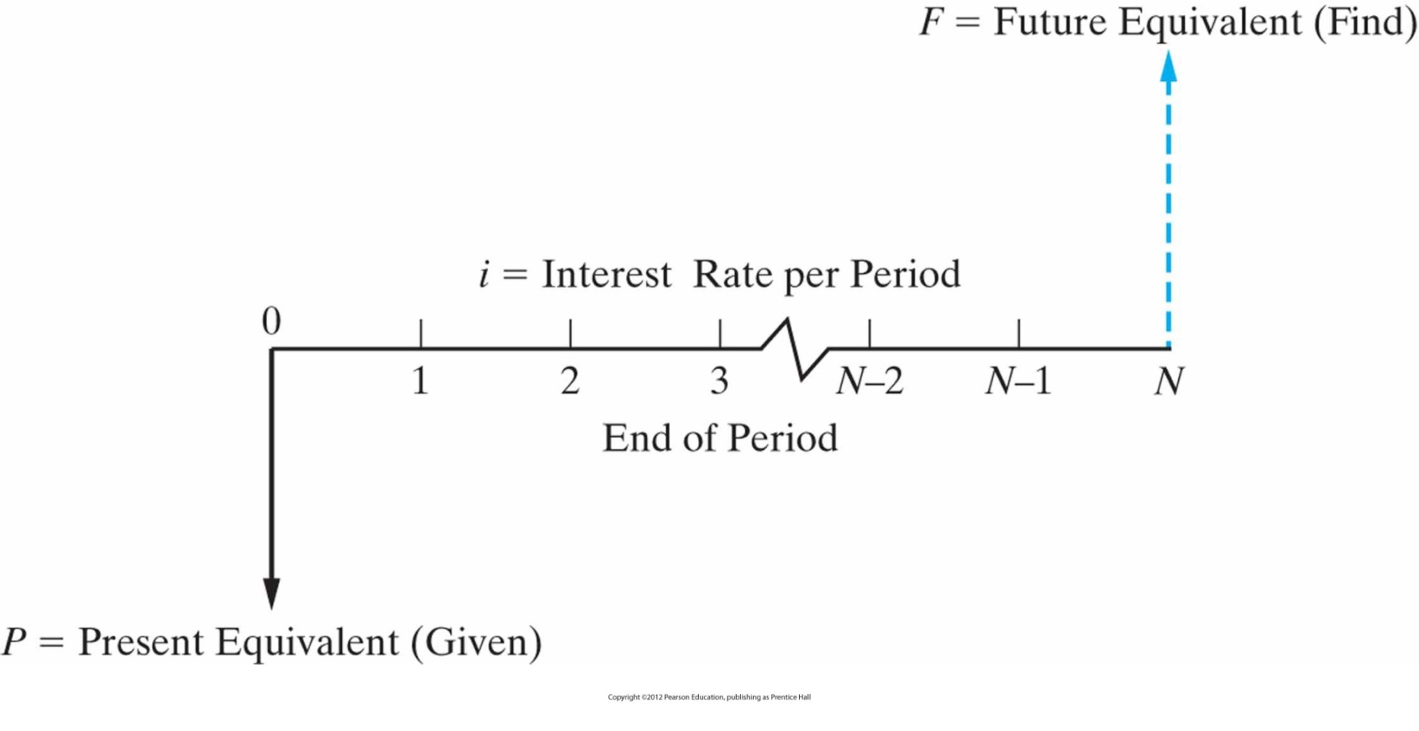
Present Equivalent and Future Equivalent of Single Payments

Slide 17
Functional Notation
Each of these expressions corresponds to an equation – see Appendix C in text:
Interest and Annuity Tables for Discrete Compounding
See also compound interest formulas on p. 134 or 619
Problems can be solved using either
functional notation and discrete compounding tables, or
direct use of the underlying equation
use of a spreadsheet - excel

Slide 18
Sinking Funds
Create a “sinking fund” to buy equipment in the future –
deposit an amount of money A at end of every period to purchase equipment that costs F in year N, assuming i% interest every year
F
0
1
2
3
N = 4
A
A
A
A

Slide 19
Sinking Funds
Must find the equivalence between F and A at interest rate i
F
0
1
2
3
N
A
A
A
A
Algebraic Solution
Functional Notation

Slide 20
Pop Quiz!
Every year you deposit $2,000 into an account that earns 2% interest per year. What will be the balance of your account immediately after the 30th deposit?
$44,793
$50,000
$57,385
$81,136
$60,000

Slide 21
Present from a Series of Cash Flows
Example 4
How much is needed today to provide an annual amount of $50,000 each year for 20 years, at 9% interest each year?

Slide 22
Finding A Given F
Example 5
How much would you need to set aside each year for 25 years, at 10% interest, to have accumulated $1,000,000 at the end of the 25 years?

Slide 23
Finding A Given P
If you had $500,000 today in an account earning 10% each year, how much could you withdraw each year for 25 years?

Slide 24
Pop Quiz!
True or False:
True
False

Slide 25
Summary of Excel Functions
PV = Present Value
FV = Future Value
PMT = Annuity
NPV = Net Present Value (same as PV but for
varying amounts)

Slide 26
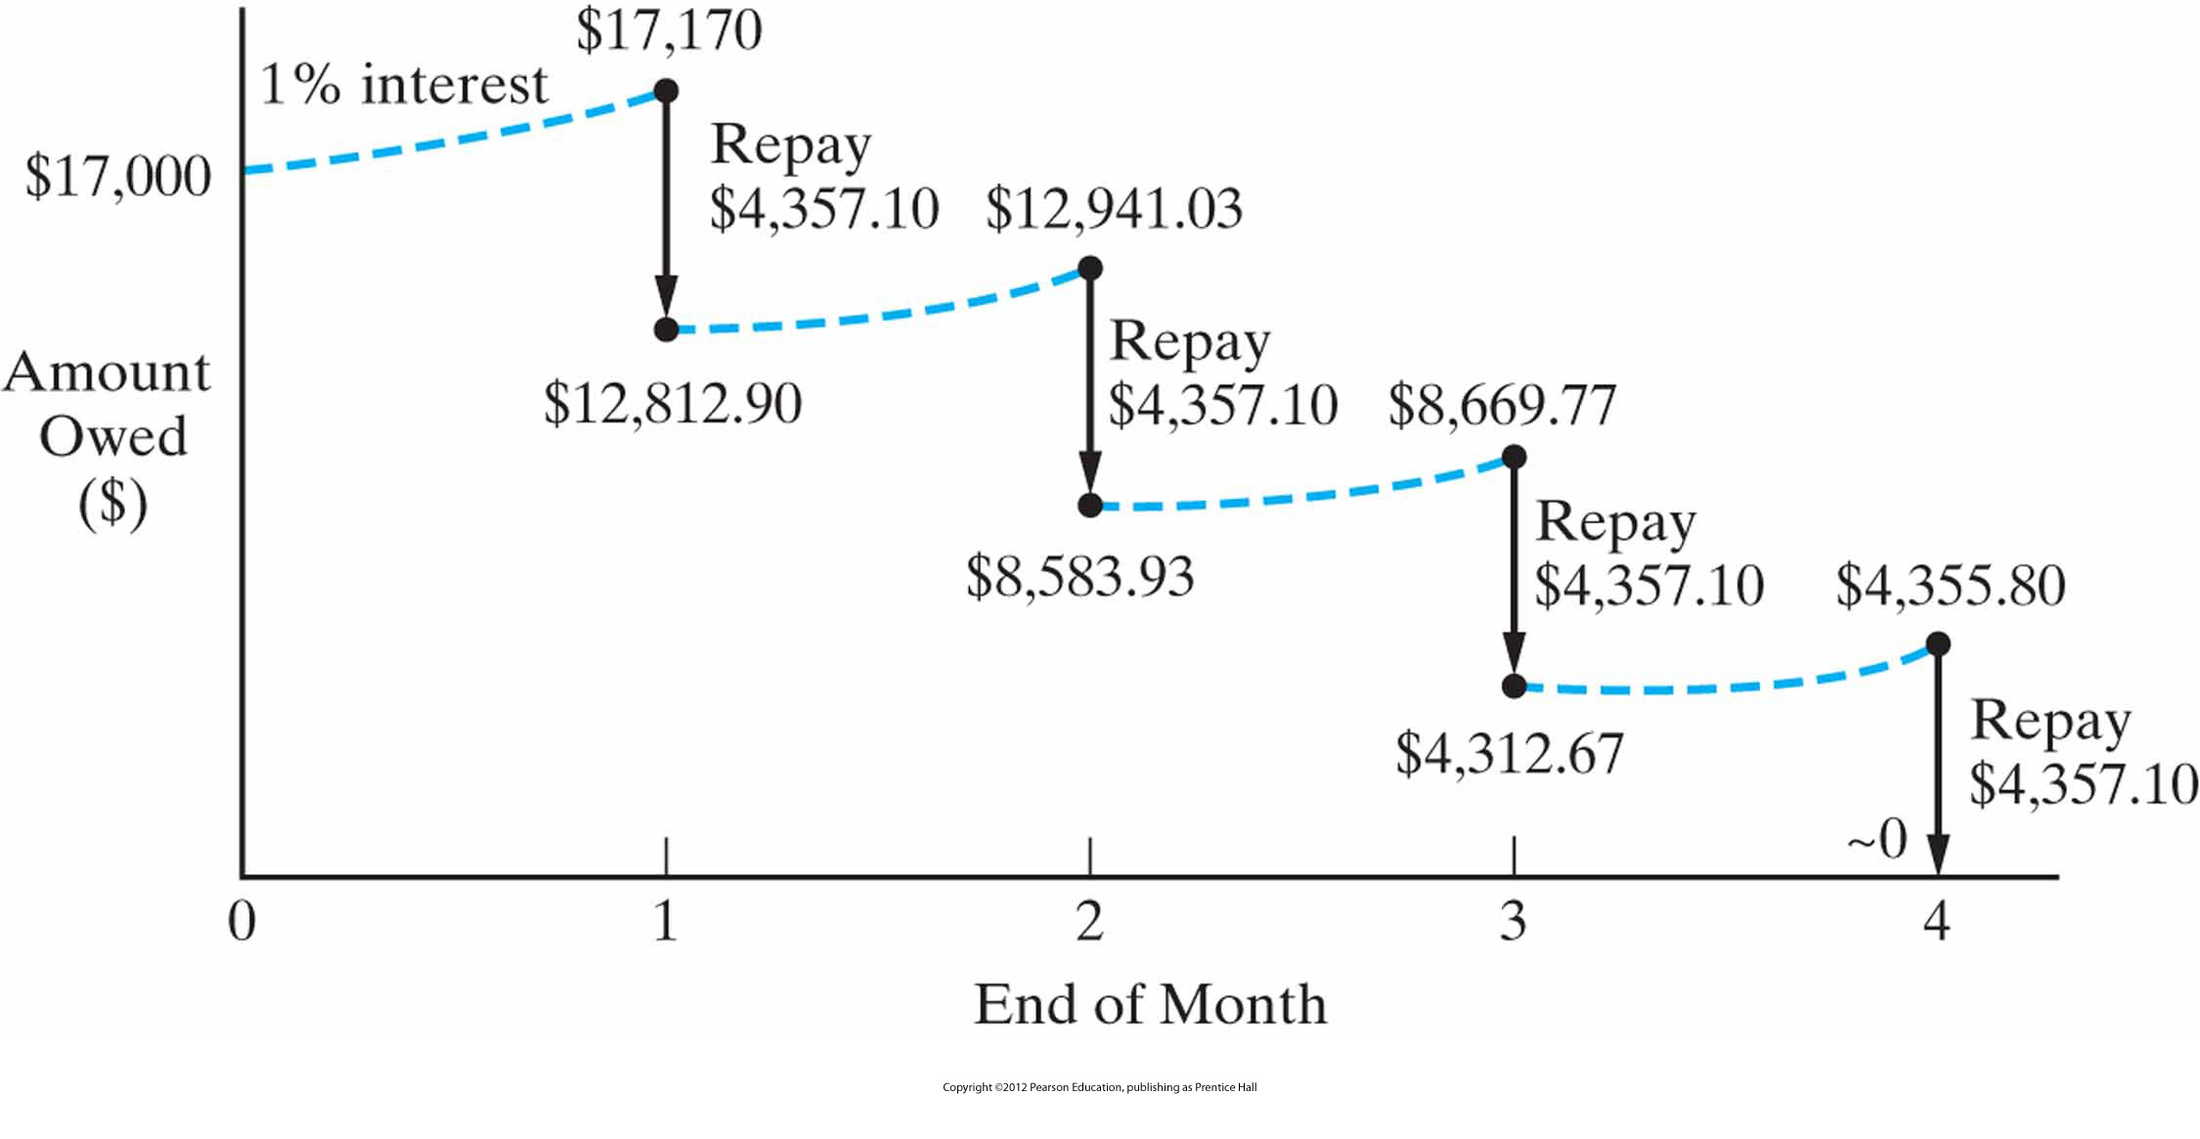
Repaying a $17,000 Loan Principal
Recall the $17,000 Loan at 1%?
It is a case of finding A given P!

Slide 27
Example 6: Equipment Decision
If your company buys new construction equipment, it will save $22,000 per year in labor and material costs
The equipment has an expected life of 5 years, and no salvage value
The company MARR is 15%
What is the maximum price that your company should pay for the construction equipment?
A = $22,000
P = A (P/A, i, N)
= 22,000 (P/A, 15%, 5)
= 22,000 (3.3522)
= $73,748
N = 5 years
i = 15%
1
2
3 4 5
P = ?

Slide 28
Snapshot of Ordinary Annuity

Slide 29
Exercise
A 50-kilowatt gas turbine has an investment cost of $40,000
It costs another $14,000 for shipping, insurance, site preparation, fuel lines, and fuel storage tanks
The operation and maintenance expense for this turbine is $450 per year. Additionally, the hourly fuel expense for running the turbine is $7.50 per hour, and the turbine is expected to operate 3,000 hours each year
The cost of dismantling and disposing of the turbine at the end of its 8-year life is $8,000
If the MARR is 15% per year, what is the annual equivalent life-cycle cost of the gas turbine?
What percent of annual life-cycle cost is related to fuel?

Slide 30
Recap of Today’s Goals
Simple vs Compound Interest
Notation and Cash Flow Diagrams
Simple Excel Functions
Relating Present & Future Equivalent Values
Single cash flows
Uniform series (annuity)

