Slide 1

Evaluating Foam Degradation and Fuel Transport Rates through Novel Surfactant Firefighting Foams for the Purpose of AFFF Perfluorocarbon Replacement
Katherine Hinnant, Art Snow, Spencer Giles, Xiao Zhuang¹ and Ramagopal Ananth
Chemistry Division, U.S. Naval Research Laboratory
¹ASEE Post-Doc, Chemistry Division, U.S. Naval Research Laboratory
Spring Technical Meeting Eastern States Section of the Combustion Institute
State College, PA March 4-7 2018

Slide 2
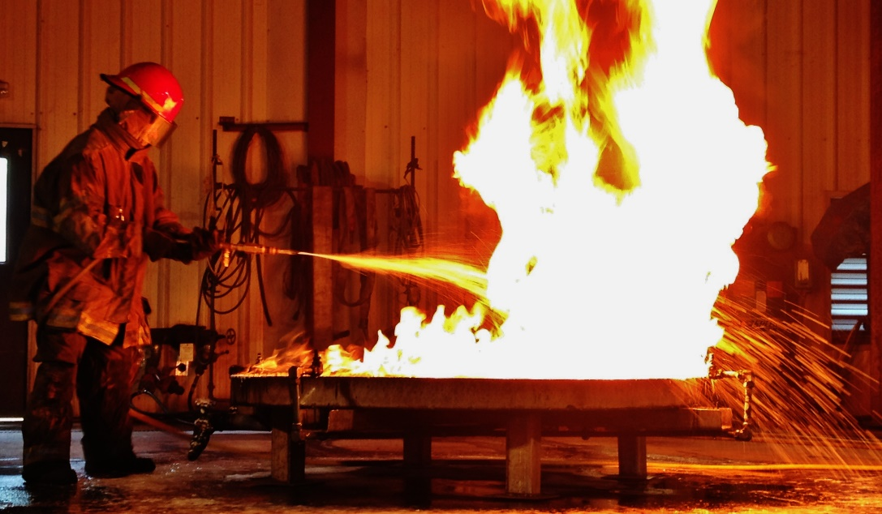
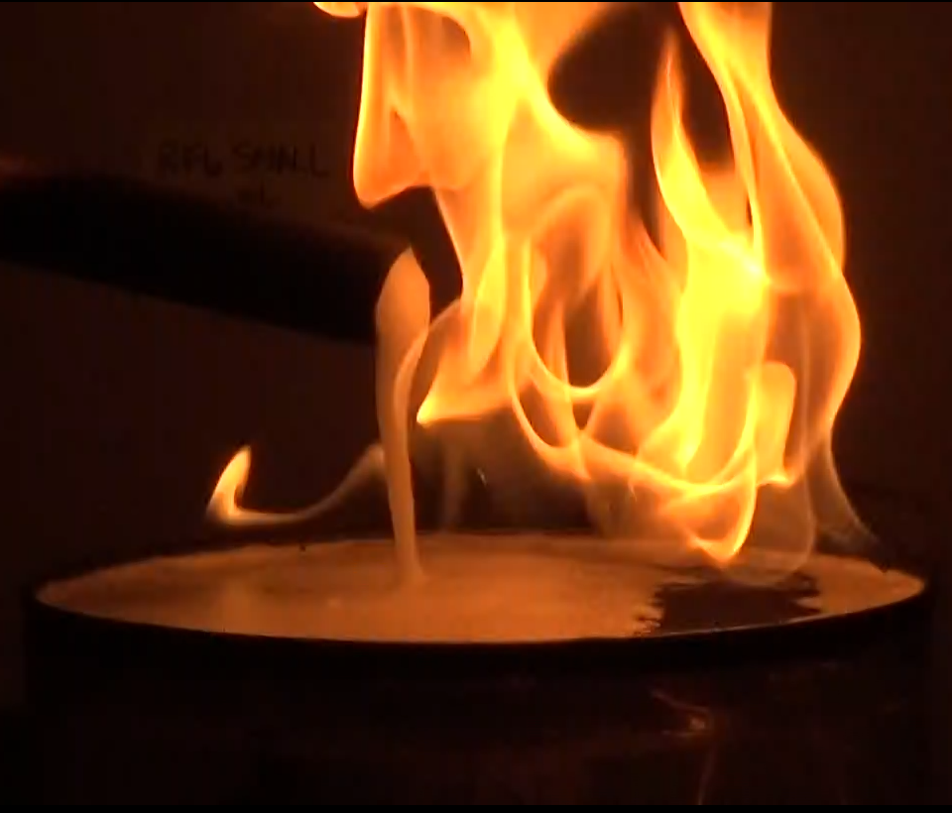
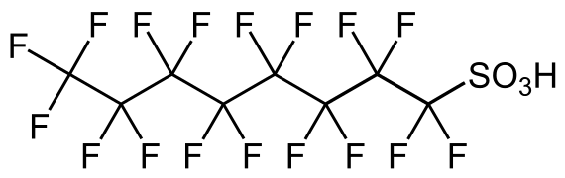
Evaluating Foam Degradation and Fuel Transport Rates through Novel Surfactant Firefighting Foams for the Purpose of AFFF Perfluorocarbon Replacement
Katherine Hinnant, Art Snow, Spencer Giles, Xiao Zhuang, and Ramagopal Ananth
Chemistry Division, U.S. Naval Research Laboratory
Background
AFFF, used to fight Class B fires, contain fluorocarbon surfactants, harmful to the environment and humans
Regulated efforts to reduce environmental impact have aimed at reducing the fluorocarbon tail of the surfactant, whose biodegradation is not well understood
Our research is aimed at eliminating fluorinated compounds from AFFF
Important Mechanisms of Fire Suppression
Previous research aimed at understanding the role of fluorocarbon surfactants in AFFF
Demonstrated importance of foam to maintain coverage of the pool surface (foam degradation) and reduce transport of fuel vapors through the foam (fuel transport)
Fluorocarbon surfactant:

Slide 3
Evaluating Foam Degradation and Fuel Transport Rates through Novel Surfactant Firefighting Foams for the Purpose of AFFF Perfluorocarbon Replacement
Katherine Hinnant, Art Snow, Spencer Giles, Xiao Zhuang, and Ramagopal Ananth
Chemistry Division, U.S. Naval Research Laboratory
Focus on Extinction Mechanisms
Novel commercial surfactants are not designed for firefighting, but can be used to relate surfactant structure to mechanisms of fire suppression
To better distinguish potential surfactants useful for firefighting, we must focus on mechanisms of fire suppression that impact extinction: foam degradation and fuel transport through the foam
We evaluated two commercial siloxane surfactants and two hydrocarbon surfactants with different head lengths and tail structure. Evaluated as a single surfactant and in a formulation¹ mixed with a solvent and a hydrocarbon surfactant

Slide 4
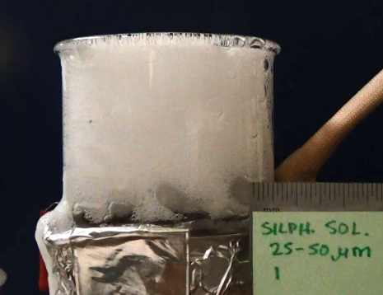
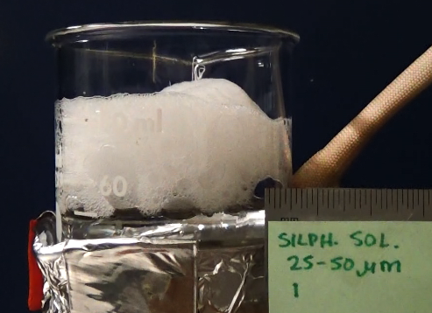
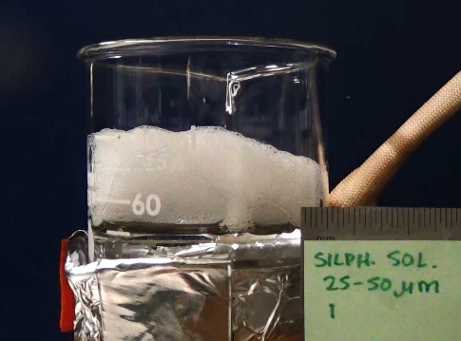
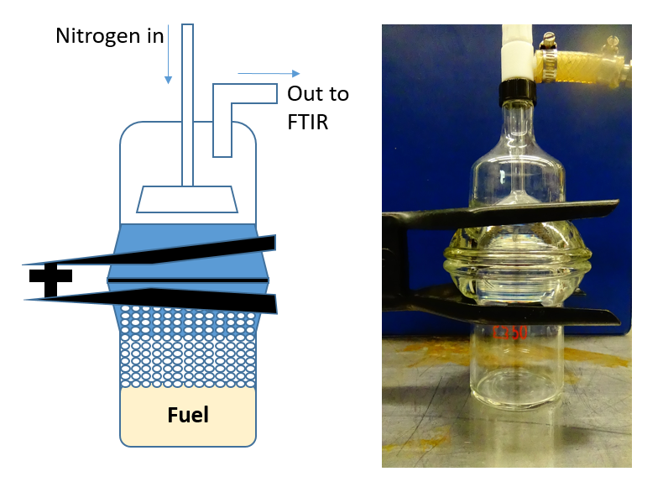
Evaluating Foam Degradation and Fuel Transport Rates through Novel Surfactant Firefighting Foams for the Purpose of AFFF Perfluorocarbon Replacement
Katherine Hinnant, Art Snow, Spencer Giles, Xiao Zhuang, and Ramagopal Ananth
Chemistry Division, U.S. Naval Research Laboratory
Foam Degradation Experiments²
4 cm of foam generated onto a heated n-heptane pool (60°C)
Heptane heated with a water bath surrounded by heating tape
Camera monitored change in foam height over time
Trials repeated three times for precision
Time: 0 min 3 min 4 min
Fuel Transport Experiments
Manufactured glass fuel transport apparatus
Open: fuel heated with a water bath surrounded by heating tape, 4 cm of foam generated on top of heated pool
Closed: sealed with a gasket, sparger flowing nitrogen to surface of foam, sweeping nitrogen and fuel vapors to an FTIR
Trials repeated three times for precision

Slide 5
Evaluating Foam Degradation and Fuel Transport Rates through Novel Surfactant Firefighting Foams for the Purpose of AFFF Perfluorocarbon Replacement
Katherine Hinnant, Art Snow, Spencer Giles, Xiao Zhuang, and Ramagopal Ananth
Chemistry Division, U.S. Naval Research Laboratory
Siloxane A formulation has longest foam lifetime (15 min)
Foam lifetime is improved when surfactant mixed in a formulation
Siloxane A formulation lifetime much smaller than commercial and Ref AFFF
Terg 15-S-7 formulation degrades in 7 min, better than the Siloxane B formulation, no conclusions on best surfactant type

Slide 6
Evaluating Foam Degradation and Fuel Transport Rates through Novel Surfactant Firefighting Foams for the Purpose of AFFF Perfluorocarbon Replacement
Katherine Hinnant, Art Snow, Spencer Giles, Xiao Zhuang, and Ramagopal Ananth
Chemistry Division, U.S. Naval Research Laboratory
Siloxane B surfactant degraded too quickly to take useful measurements (foam lifetime less than 1 min)
Siloxane A outperforms Siloxane B, Terg 15-S-7 outperforms Terg TMN6 but multiple structural differences could be the cause
Siloxane A formulation has slow fuel transport rates, but is still significantly faster than the Ref AFFF
Surfactants in a formulation have slower fuel transport rates than surfactants alone

Slide 7
Evaluating Foam Degradation and Fuel Transport Rates through Novel Surfactant Firefighting Foams for the Purpose of AFFF Perfluorocarbon Replacement
Katherine Hinnant, Art Snow, Spencer Giles, Xiao Zhuang, and Ramagopal Ananth
Chemistry Division, U.S. Naval Research Laboratory
Conclusions
None of the novel surfactants evaluated matched the foam degradation or fuel transport performance of the reference or commercial AFFF
Surfactant structure significantly affects both degradation and transport for both siloxane and hydrocarbon surfactants
Expectation would be that NRL’s siloxane formulation extinguishes faster than the other surfactants evaluated
Future Research
We aim to make changes in synthesized surfactants to systematically relate surfactant structure to extinction mechanisms. Synthesis will focus on the most promising surfactant found by NRL: Siloxane A. Emphasis will be put on understanding the siloxane structure in order to optimize foam degradation and fuel transport performance, important for rapid fire extinction.

Slide 8
Evaluating Foam Degradation and Fuel Transport Rates through Novel Surfactant Firefighting Foams for the Purpose of AFFF Perfluorocarbon Replacement
Katherine Hinnant, Art Snow, Spencer Giles, Xiao Zhuang, and Ramagopal Ananth
Chemistry Division, U.S. Naval Research Laboratory
Thank you!
This research was funded by the Office of Naval Research (ONR) through a 6.2 research program and the Strategic Environmental Research and Development Program (SERDP) under grant WP2739. We also acknowledge Dr. James Fleming for advising in this research.
References:
1. K. Hinnant, S. Giles, A. Snow, J. Farley, J. Fleming, R. Ananth, “An Analytically Defined Fire Suppresing Foam Formulation for the Evaluation of Fluorosurfactant Replacement” Journal of Surfactants and Detergents, Submitted.
2. K. Hinnant, M. Conroy, R. Ananth, “Influence of fuel on foam degradation for fluorinated and fluorine-free foams” Colloids and Surfaces A, 522(2017), 1-17.

Slide 9
Evaluating Foam Degradation and Fuel Transport Rates through Novel Surfactant Firefighting Foams for the Purpose of AFFF Perfluorocarbon Replacement
Katherine Hinnant, Art Snow, Spencer Giles, Xiao Zhuang, and Ramagopal Ananth
Chemistry Division, U.S. Naval Research Laboratory
Supplemental Slides

Slide 10
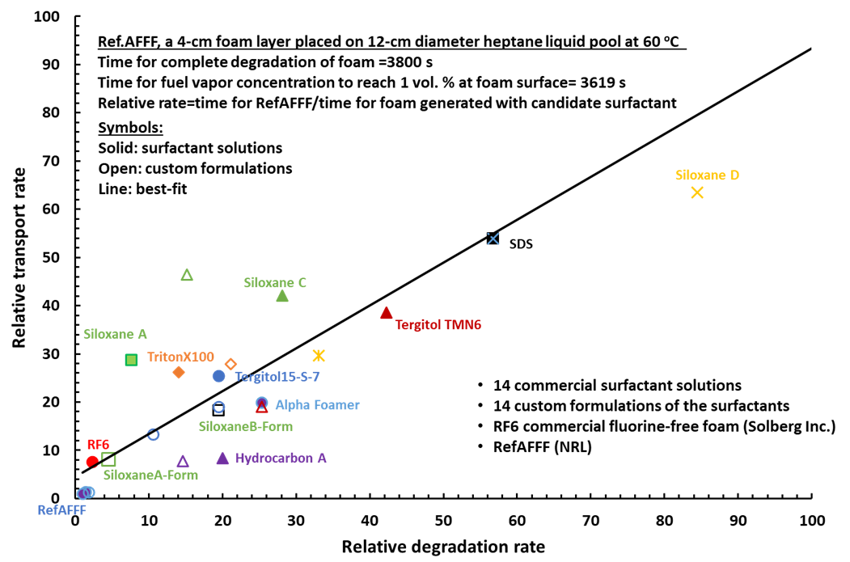
Evaluating Foam Degradation and Fuel Transport Rates through Novel Surfactant Firefighting Foams for the Purpose of AFFF Perfluorocarbon Replacement
Katherine Hinnant, Art Snow, Spencer Giles, Xiao Zhuang, and Ramagopal Ananth
Chemistry Division, U.S. Naval Research Laboratory
Fuel transport is dependent on foam degradation and both may influence the behavior of the other
Ref AFFF properties are at the origin: foams farther right degrade faster than the reference, foams farther up have faster fuel transport
Siloxane A formulation has smaller transport and degradation than individually
Notes:
Foams closest to the origin show the most potential for firefighting applications. 502W solution is the closest, but as seen from the other data presented, its fuel transport rate is still 8 times faster than the ref AFFF and its degradation is 4 times faster. Structural differences between 501W and 502W show that this change in head length effects transport and degradation. More systematic changes in surfactant structure may allude to how subtle changes effect transport and degradation to move solution properties closer to the origin.

