Slide 1
Good Morning! Welcome to Lab 11 – ECE 1020

Slide 2
Python Sensor Simulation and Data Plotting
ECE 1020

Slide 3
Reminders
Lab 10 (Python Game) is due today at 11:00AM
Lab 11 (Today’s Lab) is due next Friday at 11:00AM
If you or a team member haven’t already emailed me with your final project groups please private message me now

Slide 4
Lab 11
Objective:
Use python to graph simulated data from a sensor
Learn about important graphical commands in Python
Tools:
Python coding language
Jupyter Notebook
Where you will write/execute your code

Slide 5
How to Install Jupyter Notebook
Step 1: Install Anaconda by going here
Step 2: Selecting the your computer’s operating system (windows for PC, macOS for mac, etc.) and choose Python 3.7
Step 3: Use the default installation options
Step 4: Once finished, open Anaconda Prompt and paste the following: conda install -c conda-forge jupyterlab
Step 5: Once that command is complete, paste: jupyter notebook
At this point, Jupyter Notebook should launch in your browser.

Slide 6
Jupyter Notebook UI
Click the New button, highlighted above, to open a dropdown menu. Select “Python 3” from the dropdown menu.

Slide 7
Jupyter Notebook UI, 2
You can type your python code in the provided box above, and click Run to run it. For advanced usage, the + button creates new text boxes, and Run will only run the selected text box, allowing you to change and update parts of your code without re-running all of it.

Slide 8
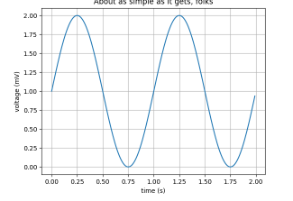
matplotlib
“Matplotlib is a comprehensive library for creating static, animated, and interactive visualizations in Python”
Useful Link: https://matplotlib.org/

Slide 9
Installing Matplotlib
Note: Step 1 will be necessary only the first time you want to use Matplotlib. Step 2 will be necessary at the start of every program that uses Matplotlib.
Step 1: Paste the following two lines into the textbox of your notebook, and run it: import sys !conda install --yes --prefix {sys.prefix} matplotlib
Step 2: Paste the following line at the start of any program that uses matplotlib: import matplotlib.pyplot as plt

Slide 10
Today’s goal
Part A
Plot dataset 1 and dataset 2, adjusting the axis and design as needed
Propose an idea of what the data could be
Part B
Create your own plot using numpy.linspace (using any range that you’d like)
Create your own plot using numpy.sin

Slide 11
Part A

Slide 12
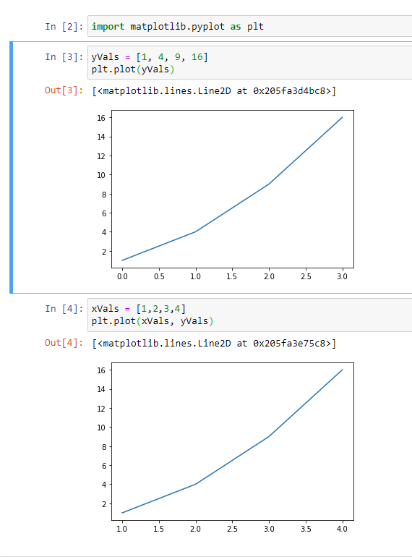
Using Matplotlib
Start by importing matplotlib
We create some data called yVals that we want to plot
Use the plt.plot command.
Notice that without assigning any x values, the x-axis starts counting from zero.
If we want to set custom x-axis values, we can do so by creating a new array and providing that to the plot command as shown.
If the plot does not show use plt.show()

Slide 13
Data Type 1 for today’s lab
data1 = [0.0068614525585179885,-0.04488667278473987,-0.11594517124619434,-0.19621817783037318,-0.2353086837319714,-0.2907457092246909,-0.3450076988977109,-0.4180703417421293,-0.49491848763524154,-0.5614421742846217,-0.601864403598885,-0.6185806587647684,-0.6685429096408156,-0.7477595739729406,-0.7281222984972143,-0.8495347551204497,-0.8497516485720957,-0.8394252573973164,-0.9502331856420859,-0.9373272407286837,-0.9521535550053574,-0.9232651566644089,-0.9961577756654019,-1.0301938086236861,-1.0246115833194145,-0.9998138247297781,-1.0381687711580891,-0.9603976947882049,-1.0300934944981321,-0.9297677681683989,-0.9499060728184245,-0.9357076634891757,-0.9230387375811313,-0.8361323917243589,-0.8937563198932731,-0.8170507964971766,-0.7952706924584942,-0.7319932527931935,-0.728710318291738,-0.6706410207482278,-0.5740749172559925,-0.5840961673711086,-0.459469975527636,-0.46637920988405185,-0.41264460742985165,-0.2869760294330511,-0.21332961161390257,-0.1511990036384664,-0.11726513556835791,-0.09689883543946268,0.04579154470324258,0.03576207509047845,0.10835612767450473,0.19618573770307782,0.22448186792735397,0.2751841197945278,0.3964476008725469,0.4470439269763206,0.5254461138836058,0.5792330833250953,0.6289931580195238,0.6323082068243908,0.6826626596497202,0.7214741476589926,0.7994812759273185,0.8228187609467238,0.7950349736239684,0.8849766476415675,0.9475851045419142,0.9243021294809551,0.9806192713958399,0.9285096609214404,1.027201121204104,0.9483180119466118,1.03849976292411,0.9838311676800938,0.9811762842656429,0.9634774325955663,0.9445693991129583,0.925962016845526,0.9858805449050665,0.9646678208838206,0.9338158044853093,0.8291571175091167,0.7952020868412099,0.8025798817709587,0.8106441193897265,0.7519170011321672,0.6854242451600763,0.6783712855495067,0.5430822676570723,0.5527307782243382,0.49893691279035923,0.39075522678964103,0.3466102360344902,0.3238300589981675,0.2919141247643603,0.18068135639590563,0.08356737552059934,0.10169323163852183,-0.023471066564094825]
Highlight the above text and paste it into your notebook to import the data.

Slide 14
Data Type 2 for today’s lab
data2 = [0.6430159895433118,-0.692818795331055,-0.05765364913329929,-0.18247456949241259,0.8187920128679362,0.5443243041337689,0.6915580882582426,0.7441096423262223,2.101849186768287,0.8998221089340923,1.5639522520077238,2.9842246942702024,2.8045794133157176,2.3687570857771614,3.5735038732894306,2.912929243690022,3.3569555242544187,4.119526721544498,3.273182143937043,4.005086964973182,5.014977440136025,4.326770736341351,5.471564386270084,4.512853932170796,5.708499149049969,4.2853666344729024,6.1222546347822,4.752858750811935,6.115107605627005,5.491723552749491,5.440483579969044,6.603740255305509,7.2210129770194795,6.0750710479763805,6.82959990533339,6.195410987610472,6.95755958265538,7.192696875903116,8.555574754789632,7.554164125659067,7.604524210153054,8.583404857013102,7.765660664449412,8.85655006652317,8.568009739462696,8.961957176985655,10.358921384814721,8.691142993204608,8.997816317170255,9.91368025492215,9.655134670945747,10.659973638619483,10.429869770660055,10.292075390108636,10.054017643400357,9.343221901092747,9.426105424008421,8.548380142757452,10.109359862318302,8.09908672198068,9.341831540803517,8.783816134687527,8.583208346846435,9.567591603448752,9.349362913085306,7.86530968957636,9.038919070986058,8.40081899138753,8.172590357058798,8.653879826122886,8.070112768828144,8.227474167945658,8.430874903471768,7.723755221338999,8.26170703957425,7.213879264553489,6.787638518854808,7.770992808335575,6.544683954577046,7.14734687972749,7.860962318954241,7.73934961397278,7.431093520349534,7.30006259796517,7.201157578863416,5.455654323863753,6.920187510038064,6.6630519439520945,5.842960709727481,5.821748776957807,4.952139572147198,5.5364778236543515,5.729430347571074,4.82727429445673,5.690001680535211,5.216670895062905,4.425289170393615,5.078458663725478,5.30246663588126,5.792398665115587]
Highlight the above code and paste it into your notebook to import the data.

Slide 15
Part B

Slide 16
numPy
A library that allows the user to work with mathematical objects such as matrices and other “scientific computing” concepts
Useful Link: https://numpy.org/

Slide 17
numpy.linspace
“Returns evenly spaced numbers over a specified interval”

Slide 18
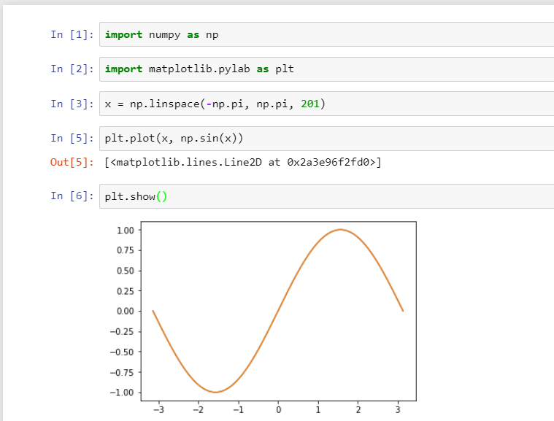
numpy.sin

