Slide 1
ECE-1010 Introduction to Electrical and Computer Engineering
Introduction to Arduino
Prepared by R. Lamond

Slide 2
Objectives
Control the rotation of standard servo motor
A standard servo motor is limited in its rotation between 0 and 180 degrees
Control the speed of a continuous rotation servo motor based on the light intensity
A continuous rotation servo motor can rotate freely without restriction

Slide 3
Introduction to Servos
A servo is a small, electrically-driven motor that provides rotary actuation
Servos are controlled by using Pulse-Width Modulation (PWM)
The duration of a voltage pulse determines how far the shaft will turn (i.e. the angle)
Servos will not hold their position indefinitely, so the position pulse must be sent repeatedly
The holding force of a servo is determined by it’s torque rating

Slide 4
PWM Generation
There are 2 different ways in which you can generate a PWM signal
Use the built-in PWM pins on the Arduino where you only need to set the duty cycle
Manually generate one by alternating voltage HIGH and LOW with specified delays
We will use the manual method since the built-in PWM frequency does not match the servo’s expected pulse timing

Slide 5
Part 1 – Controlling Servo Rotation (Manual PWM)
int servoPin = 4; //variable to store the servo pin number
int pulse = 700; //variable to store the pulse duration
void setup()
{
pinMode(servoPin, OUTPUT); //set the servo pin as an output
Serial.begin(9600); //set serial data transfer rate
}
void loop()
{
digitalWrite(servoPin, HIGH); //send 5V to the servo
delayMicroseconds(pulse); //for pulse microseconds
digitalWrite(servoPin, LOW); //send 0V to the servo
delay(20); //for 20 milliseconds
}
You can change the duration of the pulse to vary the servo’s rotation angle.

Slide 6
Part 1 Schematic (Manual PWM)
Standard servo

Slide 7
Part 1 Board Layout
Servo
motor
Pin 4
5V
Servo
connector
Ground

Slide 8
Part 2 – Continuation from Last Week
RGB LED – Get all three colors to show

Slide 9
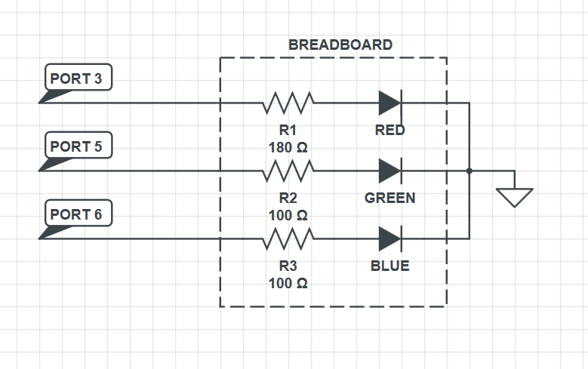
Hardware Setup

Slide 10
//PART 2: Modifying existing code to gain understanding
//you need to add the blue LED code
int REDPin = 3; // RED pin of the LED to PWM pin 3
int GREENPin = 5; // GREEN pin of the LED to PWM pin 5
// BLUE pin of the LED to PWM pin 6
int brightness = 0; // LED brightness
int increment = 5; // brightness increment (changing this will change the smoothness of transitions)
void setup()
{
pinMode(REDPin, OUTPUT);
pinMode(GREENPin, OUTPUT);
//blue pin mode definition
}
void loop()
{
brightness = brightness + increment; // increment brightness for next loop iteration
if (brightness <= 0 || brightness >= 255) // reverse the direction of the fading
{
increment = -increment;
}
brightness = constrain(brightness, 0, 255); //function which limits a value to a range
analogWrite(REDPin, brightness);
analogWrite(GREENPin, brightness);
//blue pin value refresh
delay(20); // wait for 20 milliseconds to see the dimming effect
}

Slide 11
References
http://arduino.cc
http://arduino.cc/en/Tutorial/HomePage
http://learn.adafruit.com/adalight-diy-ambient-tv-lighting

