Slide 1
ECE-1010 Introduction to Electrical and Computer Engineering
Introduction to Arduino
Prepared by R. Lamond

Slide 2
What is Arduino?
“Arduino is an open-source electronics prototyping platform based on flexible, easy-to-use hardware and software. It's intended for artists, designers, hobbyists, and anyone interested in creating interactive objects or environments” (arduino.cc)
Consists of both software and hardware:
Software: The Arduino language (a variant of C)
Hardware: The Arduino Uno in our case (other boards exist)

Slide 3
What can I do with Arduino?
Gather sensor data
Actuate servos
Process image data and light LEDs
Communicate with smartphones for home automation
Many, many more possibilities! Arduino (or a similar microcontroller) may be crucial to your senior design project!

Slide 4
Arduino Can Do Great Things!

Slide 5
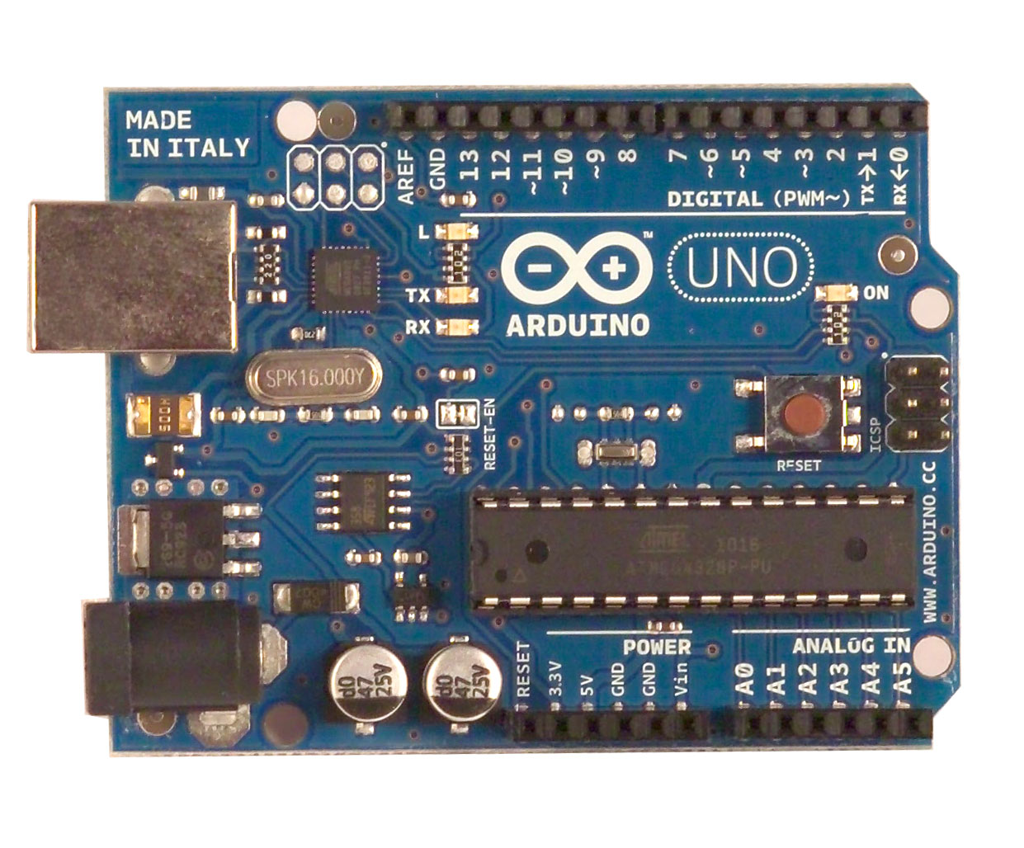
Meet the Board
Digital / PWM Ports
USB
PORT
Microprocessor
5 V
Power Ports
Analog Ports
We’ll talk about the Arduino later on.

Slide 6
Arduino Language: The Basic Structure
Basic Arduino code has three general sections:
Variable declaration: int x = 3; //this is a comment! int y = 0; //ect…
Setup Loop: void setup()
{ //This code runs before everything else. //pin setup and communications setup pinMode(x, OUTPUT); }
Main program loop: This is where the majority of your code goes! void loop()
{ y=x; //ect… }

Slide 7
A note on syntax
Arduino syntax is quite similar to interactive C as they are both “C-based” languages
If you get confused about syntax today, think back to your work with robots!
Arduino commands are quite different from IC, so you may have to consult references (or your instructor) to determine the proper usage.

Slide 8
Today’s Objectives
Become familiar with the Arduino Uno and Language:
Understand and upload some sample code to the Arduino Uno
Understand and edit some more complex code, modify it to add functionality, and upload to the Arduino Uno

Slide 9
Todays Objectives (Cont.)
But what are we actually making?
A hardware/software system which makes a single color LED blink on and off
A hardware/software system which makes three colored LEDs pulse between very dim and very bright
What parts will we need?
1 computer
1 Arduino Uno Board
1 RGB LED
1 Breadboard
3 Resistors (2 x 100Ω, 1 x 180 Ω)

Slide 10
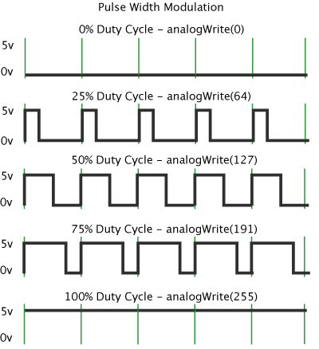
PWM: A Quick Intro
PWM: Pulse Width Modulation
A simple way of mimicking an analog signal using a digital one
Very useful for devices which lack an analog output (like Arduino!)
To power an LED, we need an analog voltage (in this case, approximately >2.5 V)
Arduino has PWM built in for voltages between 0V and 5V
5V = a PWM value of 255
0V = a PWM value of 0
You can use any value between 0 and 255 for PWM on an Arduino
http://arduino.cc/en/Tutorial/PWM

Slide 11
Why Do We Need Resistors?
LEDs are very sensitive to changes in current
The current in an LED varies exponentially with voltage, therefore small increases in voltage are potentially dangerous!
Resistors vary linearly with voltage
Using a resistor in series with an LED will limit the current through the LED, minimizing the risk of damage

Slide 12
A Blinking LED
First Step: Set up Hardware
Second Step: Walk through the code step by step
Third Step: Learn how to download code to the Arduino

Slide 13
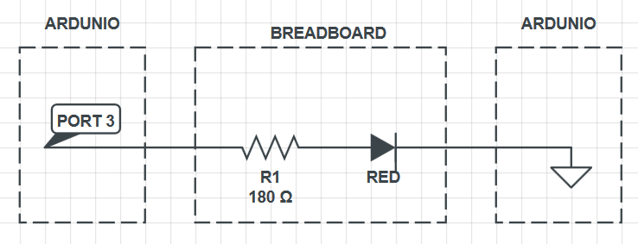
Hardware Setup

Slide 14
The Breadboard

Slide 15
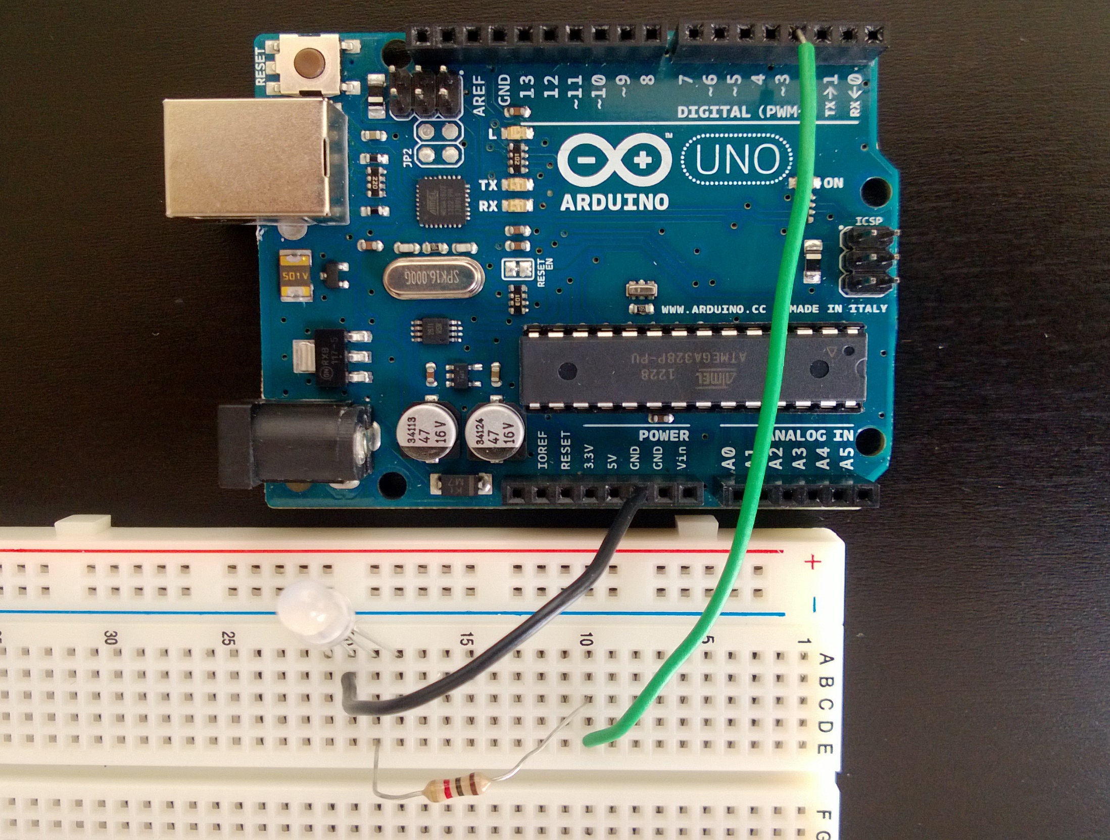
Hardware Setup (2)
PORT 3
GROUND

Slide 16
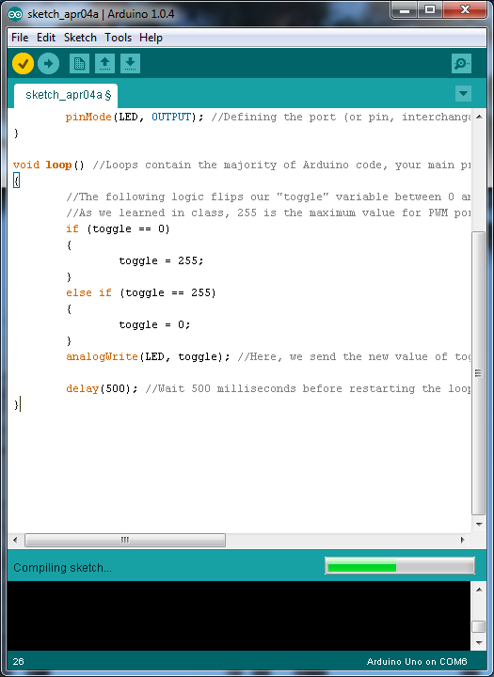
HW/SW Interaction
Connect the Arduino to your PC via the USB cable
Open the Arduino software (arduino.exe)
This is where you can write/edit your code
It will tell you if there are errors during compilation
Press the check mark to compile your code
Press the right facing arrow to download your code to the board

Slide 17
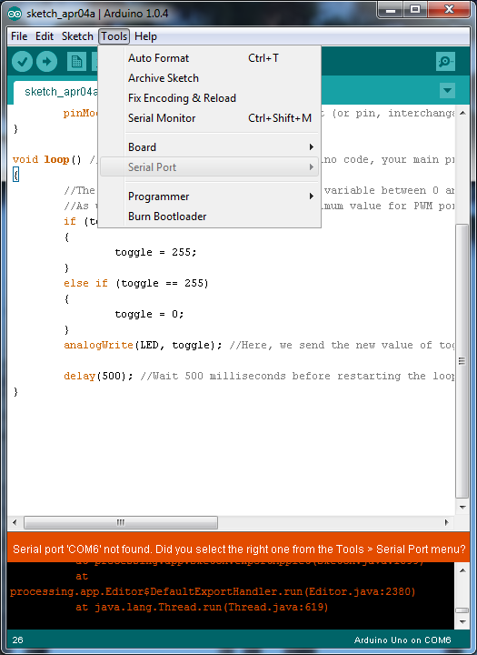
HW/SW Addendum
You may have to change the COM port through which the software and Arduino board communicate
Ask your GTA for help if there is any confusion

Slide 18
//PART 1: Reading and running basic Arduino code
//Variable Declaration
int LED = 3; //Define which port on the Arduino board will be used
int toggle = 0; //Setup a variable which turns the LED on and off
void setup() //All arduino programs have setup loops. This code runs before everything else. Put pin setup and communications setup code here
{
pinMode(LED, OUTPUT); //Defining the port (or pin, interchangable) we decide upon as an output of the Arduino board
}
void loop() //Loops contain the majority of Arduino code, your main program will go within this structure.
{
//The following logic flips our "toggle" variable between 0 and 255
//As we learned in class, 255 is the maximum value for PWM ports on the Arduino board, meaning a PWM port set at 255 will output a constant 5 volts
if (toggle == 0)
{
toggle = 255;
}
else if (toggle == 255)
{
toggle = 0;
}
analogWrite(LED, toggle); //Here, we send the new value of toggle to the port LED (which we defined as port 3 on line 1).
delay(500); //Wait 500 milliseconds before restarting the loop; this way we get a flashing LED!
}//Make sure to close your brackets!

Slide 19
Now It’s Your Turn!
Check out an Arduino from your GTA and a USB cable from the lab techs
Build the device we just discussed
Don’t hesitate to ask when you have questions!
Next: using all three colors!

