Slide 1
Prototyping Your Idea and Opportunity Recognition
Summer 2017
Session 2
06/14/2017

Slide 2
Exercise
The cost for operating a commercial truck is where k is a constant of proportionality, v is velocity in miles per hours, and n is the trip length in miles. It is estimated that at 85 mph, the average cost of operation is $52 per mile. The truck owner wants to minimize the cost of operation, which needs to balance against the cost of delays and unscheduled maintenance, which is assumed to be $10 per hour. What is the optimum velocity needed to minimize the total costs?

Slide 3
Objective
The objectives of today’s class are:
  What is prototyping and why do it?
  Determining your type of prototypes
    Minimum Viable Product (MVP)
  Identifying an opportunity
  The ideation to opportunity transition
  What is the opportunity space?
  Knowing you customer
Notes:
Also G, g -- introduced later

Slide 4
Why Prototyping?
Introducing a new product or service involves substantial risk, and upwards of 50-90% of innovations fail
There is often a large gap between what the entrepreneur believes is valuable and what the target customer perceives.
Prototyping, both products and services alike, is one strategy to test key assumptions about what a customer will value and be willing to buy.

Slide 5
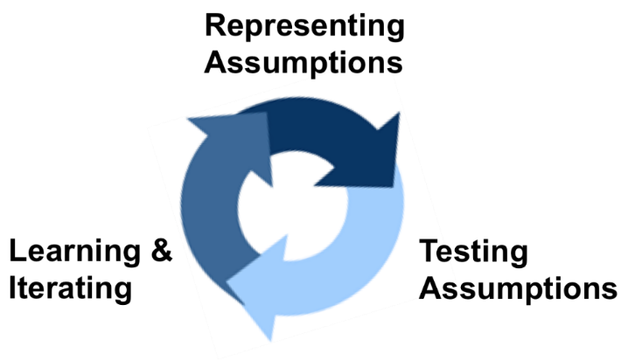
What is prototyping?
Prototyping is the iterative process of quickly putting together working models in order to represent ideas, test various aspects of a design, and gather early customer feedback, over and over again until obtaining the most suitable product.
The core purpose of the prototyping process and developing a prototype is to get a response from a target customer or user -- in other words, feedback which can be acted on.

Slide 6
Why Prototyping?
Introducing a new product or service involves substantial risk, and upwards of 50-90% of innovations fail
There is often a large gap between what the entrepreneur believes is valuable and what the target customer perceives.
Prototyping, both products and services alike, is one strategy to test key assumptions about what a customer will value and be willing to buy.

Slide 7
Prototyping should answer the following questions
Does my target customer want the new product I propose creating?
How might I alter the product or service to make it more attractive to my target market?
And how does my proposed innovation compare against existing solutions in the marketplace?

Slide 8
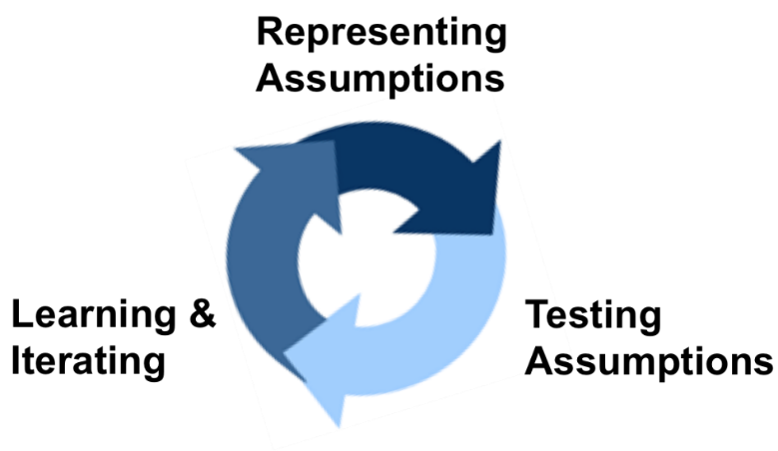
The Prototyping Process
Representing Assumptions
Make tangible or livable the value your product or service will offer so that the target customer can see, try or experiment with it.
Testing Assumptions
Test what you have made tangible or livable by having your target customers use your prototype.
Learning and Iterating
Collect feedback from target customers and act on it by creating a new version of the prototype and repeating the process until you obtain a final product.

Slide 9
Some kinds of prototypes are:
Low or High Fidelity
Looks-like or Works-like
Paper Prototyping
3D printing
Electronic prototyping
Service simulators
Minimum Viable Product (MVP)

Slide 10
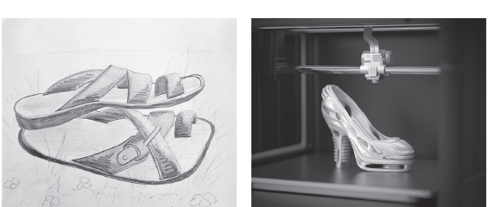
Low-fidelity vs. High-fidelity Prototypes
Quickly getting ideas out
Seeking early feedback from customers
Representing a final, polished product concept
Making final decisions about marketing and production

Slide 11

Looks-like Prototype
Test looks, design.
Valuable to test market acceptance of the design, before costly, detailed product development is started.

Slide 12
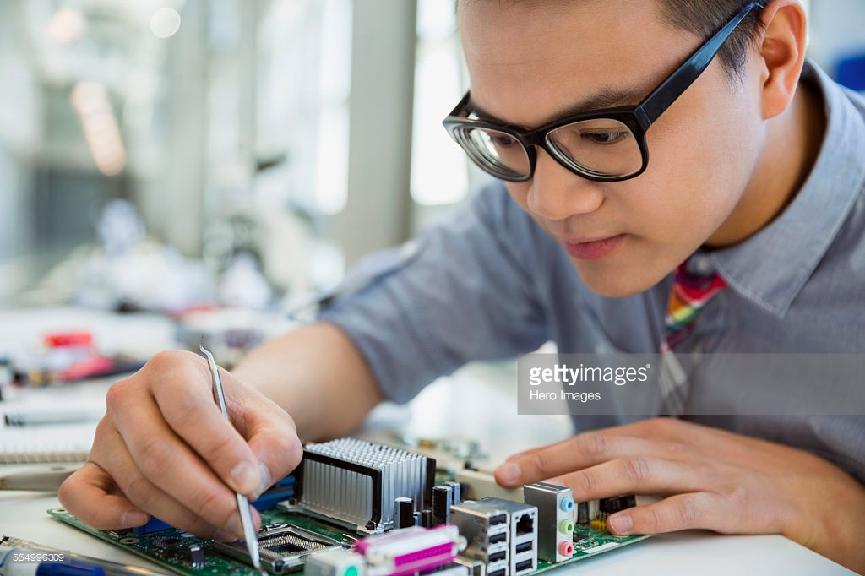
Works-like Prototypes
Test the functionality of the product.
Test the usability with the target customer before programing or manufacturing.

Slide 13
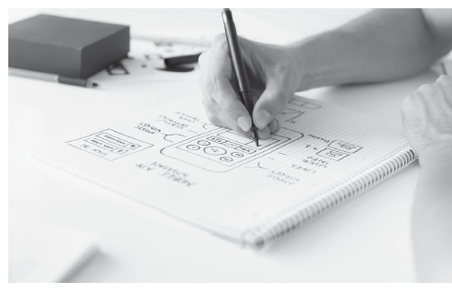
Paper Prototype
To quickly and directionally correct the basic idea of the product.
To explore what is valuable to the target customer.

Slide 14
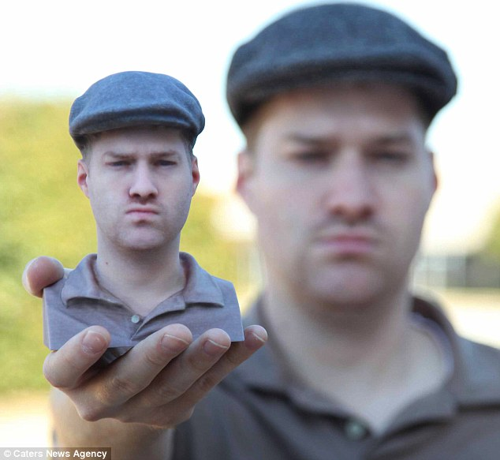
3D printing
To create looks-like and even works-like prototypes.
Its getting cheaper and cheaper.
There are companies that provide 3D printing services.
A color 3D printed model. This model was created by
taking a 3D digital scan of the man shown in the picture.

Slide 15
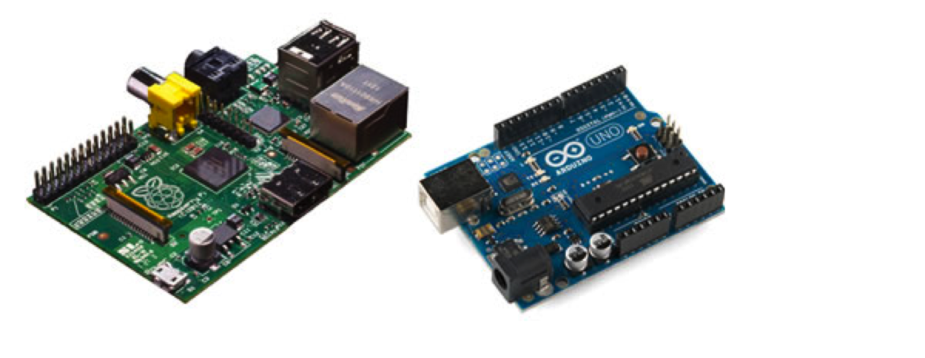
Electronic prototype
2 open-sourced projects, Arduino and Raspberry Pi.
Arduino is a platform with microcontrollers that allow DIY’s and hackers to connect sensors and actuators to test.
Raspberry Pi is a chip with which you can test computing
They are low cost.
Raspberry Pi and Arduino.

Slide 16
Prototyping and Crowdfunding
Kickstarter and Indiegogo highlight the value of prototypes in securing funding.
Entrepreneur must develop and feature looks-like to convey to their creative vision, and more importantly, to signal their professionalism and dedication to their project.

Slide 17
Prototyping = Co-creating
The most valuable step of prototyping is to design with, meaning alongside, your target audience to not only validate their needs but also to discover unexpected entrepreneurial opportunities.
Customer engagement is at the center of the product design process
Target customers must be engaged early and continuously in the process of idea generation and product development.

Slide 18
Service Simulator
Major elements of services can be prototyped as well. For example:
  A plumbing company wishing to experiment with a new 30-minute ‘arrival guarantee’ for plumbing emergencies can set aside a plumber for rapid response to test the desirability of this new service.
  An entrepreneur with a new pickup-and-delivery concept for a dry cleaner can first experiment with just the pickup-and-delivery aspect of the service without building and operating an entire cleaning operation. For example, an existing dry cleaner/cleaning operation can be used to do the cleaning itself.

Slide 19
Minimum Viable Product (MVP)
Eric Reis defines a minimum viable product as that version of a new product concept which allows a team to collect the maximum amount of validated learning about customers with the least effort¹.
Others view a minimum viable product as a more evolved prototype that can be used by the customer and actually deliver value to a customer, even in a rough form.
Ries, Eric. Minimum Viable Product: A Guide,
http://www.startuplessonslearned.com/2009/08/minimum-viable-product-guide.html,
August 3, 2009.

Slide 20
Summary
In sum, prototyping is a process and prototypes can be thought of in many ways:
  As market research and exploration tools
  As physical embodiments of a set of assumptions
  As fundraising tools for Crowdfunding efforts
  As coordination device within an entrepreneurial team to identify research and development priorities

Slide 21
Reflection points
How might you leverage prototyping to explore your idea for an entrepreneurial venture?
What simple prototype could you develop today, or this week, to test some core aspect of your concept?
How might you develop multiple prototypes to seek a wide range of feedback from your target customer?
How do you think 3D printing might change how entrepreneurs develop prototypes as well as final products?
How might you co-create opportunities with your target customer, i.e., involve them early on in your idea generation?
How might you develop and test a minimum viable product (MVP) for your product or service concept?

Slide 22
Web Exercises
Watch this 2-minute video on how to get started with simple paper prototyping: https://www.youtube.com/watch?v=k_9Q-KDSb9o. Remember, simple, low fidelity prototyping is always the place to start.
Look at Fiverr.com to discover a wide range of affordable design services including graphic design, industrial/product design, 3D design and web development.
If you did not already, look at 3Dhubs.com and Shapeways.com to learn more about 3D printing services, some which are likely available in your city.

Slide 23
OPPORTUNITY RECOGNITION, SHAPING, & RESHAPING

Slide 24
Visualizing Opportunity
Find Your Passion
Test the Market
See the Competition

Slide 25
Visualizing Opportunity
Find Your Passion
How do you spend your spare time?
What activities provide you with happiness?
Talk to people in your sphere of influence.
See the Competition
How are customers currently meeting the need that you propose to fill?
Can you differentiate between your direct and indirect competition?
Test the Market
Is this an attractive opportunity?
A series of Market Tests will allow you to gauge the viability of your opportunity.

Slide 26
Idea-to-Opportunity Transition
Seed of an idea
Passion
Professional Experience
Idea
Idea Multiplication
Viable Opportunity

Slide 27
See Yourself
Seed Resources
Passion
Experience & Knowledge
Time
Personality
Capital ($)
Energy
Experience/Knowledge is often the
“long pole in the tent”

Slide 28
Idea Multiplication:
IDEO Technique
Optimize Practicality
Brain storm /write
No judging
Create Concepts
Observe
Ask
Record
Observe
Ask
Record
Multiply Stimuli
Build a simple mock-up
Plan to iterate
Gather Stimuli

Slide 29
The Opportunity Space
(Global) Business Environment
Competitors
Your Company
Suppliers
Customers
Competitors
Competitors
Government Regulations

Slide 30
The Customer
Target Audience Categories
Primary
Target Audience
Secondary
Target Audience
Tertiary
Target Audience
Common Demographic/Psychographic Categories
Demographics
Psychographics
Age
Gender
Household Income
Family Size/Family Lifecycle
Occupation
Education Level
Religion
Ethnicity/Heritage
Nationality
Social Class
Marital Status
Social group (white collar, blue collar, etc.)
Lifestyle (mainstream, sexual orientation, materialistic, active, athletic, etc.)
Personality Traits (worriers, type-A’s, shy, extroverted, etc.)
Values (liberal, conservative, open-minded, traditional, etc.)

Slide 31
Macro Trends:
Last 50 years
Trend | Impact
Dual Income Households | Child care, In-Home Services – landscaping, housecleaning, prepared meals
Touch Computing | Tablet computers and eReaders—iPad, Amazon Kindle Fire, Samsung Galaxy, Motorola Xoom. Touch-based operating systems—Windows 8 and Mac OS X Lion
Obesity | Drain on healthcare system, growth of diet industry, changes in food industry, health clubs, home gyms
Sharing Economy | Connecting people to excess capacity, like Uber, Lyft, AirBnB
Urbanization | Growth and densification of urban areas. Urban renewal.

Slide 32
S-Curve:
The Diffusion of Product Acceptance Over Time
Obsolescence
Phase
Market Adoption
New
Competitors
Enter
Window of
Opportunity
1
2
3
Time

Slide 33
Setting Prices
Price
Penetration Pricing
Strategy
Cost-plus Pricing
Strategy
Assessing Market
Prices for Competing
Products
Strategy
Requires
Enormous
Financing
Price May Not
Match
The Value
The Best Option

Slide 34
Find “Stealth” Competitors
Sources of Intelligence
Angels & VC’s
Databases
Suppliers

Slide 35
Opportunity Checklist
Customer
Competition
Vendors
Government
Global
Environment
Trends
Market size
Price, Frequency,
Value
Market
Growth
Distribution
Key Success
Factors
Evaluate your idea to see if it is a strong opportunity.
Evaluate several ideas simultaneously to see which is most promising.
Examine weaknesses and see how you can modify your business model.

Slide 36
Recap
All opportunities start with an idea
There should be an established and growing market
Entrepreneur should have passion for the idea and know the customer
Reach customer better than the competition can
Four favorable elements: customer, competitors, suppliers and government

